Slide 1
Schedule for today
The midterm answers, quick run through
General feedback on the midterm.
The final assessment instructions,
An opportunity to ask any further questions about the final assessment

Slide 2
The midterm answers, quick run through
Regression
build a regression model understand its predictive power
b. look at beta-s, t-s and p-s
d. challenging you to look into model interrogarton methods to evaluate feature importance
RF model
KNN consideration
a. ties, data size, curse of dimensionality
c.challanging you to use LVOOCV to evaluate feature importance
Give opinion based on above
Classification
build DT to build classification model and understand its predictive power
d. challenging you to observe and understand differences in performance with different random CV splits 2.
e. challenging you to think about bias again and the implication of the model performance
build Logistic regression & compare
b. challenging you to use bootstrapping and understand the certainty of your accuracy
build LDA or QDA and compare
fit RF & compare
6. Evaluate what you have done above
b. challenging you to provide a proof

Slide 3
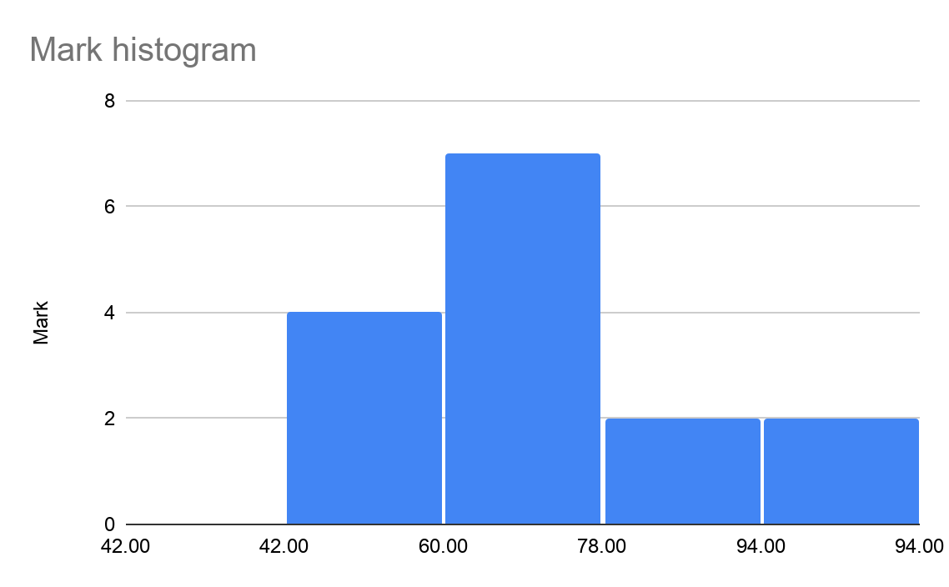
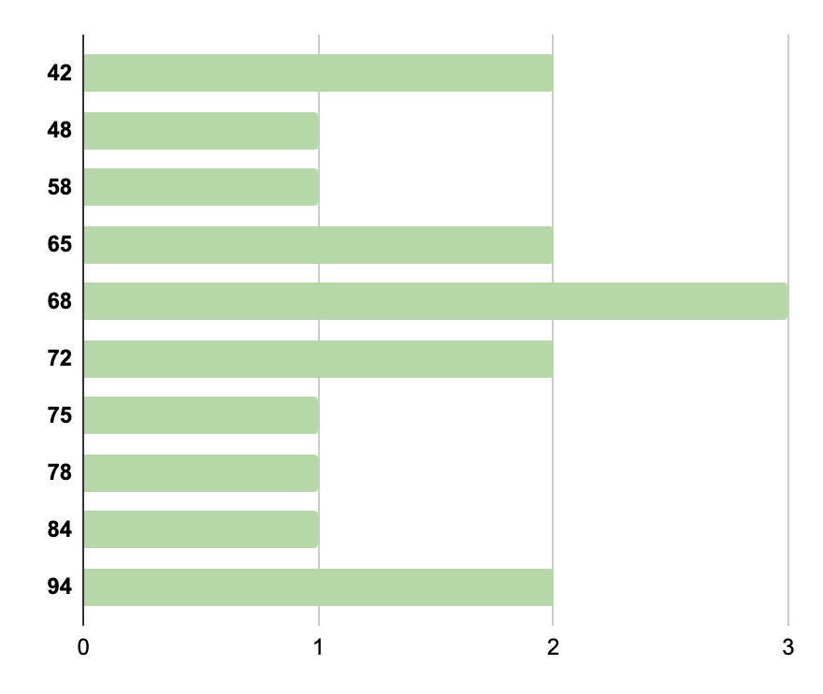
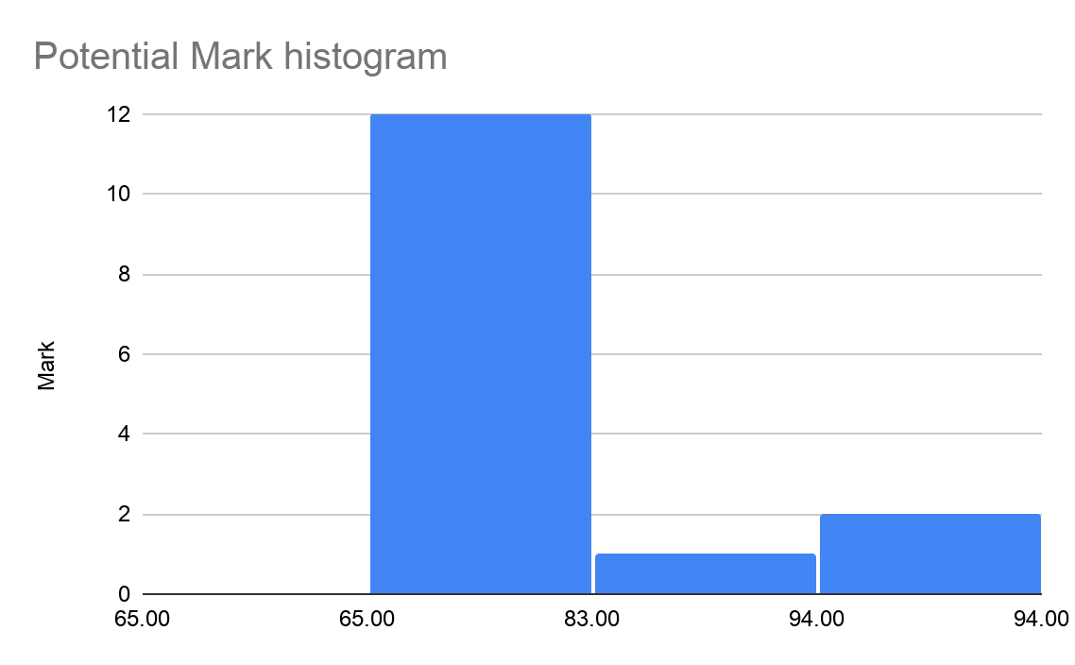
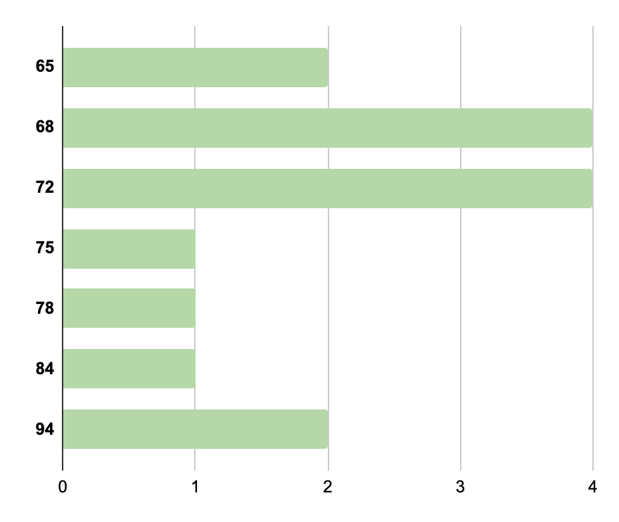
General feedback on the midterm
Average = 68
Potential Average = 74

Slide 4
Do’s
Don'ts
Provide contextual interpretation
Provide justifications
Make summaries
Focus on the goal
Keep it brief but with enough context
Write within markdown
Make it readable
Leave interpretation at “p-value is 0.03”
Use methods without demostrating why (unless specifically asked to do so)
Try not to get sidetracked
Write essays
Write in word
Insert your text into code notes #...

Slide 5
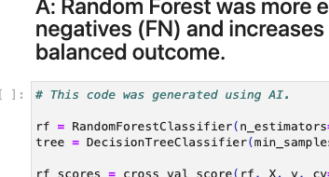
AI notes
Be aware
Commonalities in the text
  “although the predictors are measured on a common 1–5 scale, the effective dimensionality of the feature space may still reduce the meaningfulness of distance calculations” > in class explained as “ties” on categorical variable
Very good coding practice
  common mistakes are disappereaning
  unnecessarily complex code is appearing
Sidetrack to traditional statistics
In this module: Category 3 Selective
Allowed: Use of Copilot in R or Python, Use of AI for spelling (Grammarly, or other), use of LLM to aid general understanding and reframing or code help where repetitive tasks are needed…this is indirect use which requires you to build some knowledge first, but use AI to aid the labour part
Not allowed: shameless copy-pasting, any direct use/learning, over-reliance….this will affect your learning ability & will be considered as plagiarism

Slide 6
The final assessment instructions
Complete one inference and one prediction prompt: two in total
Focus on answering the question
Inspect and explore
Manage the data
Set out serious of questions that will answer the overall question
Set and execute methods to answer those questions
Iterate/adjust the pipeline to get to your goal
Inference 1 (easy): Is French Wine Overpriced?
38,686 wine ratings from all over the world
Prediction 1 (easy): How well can you predict letting rates on AirBNB?
6,700 Airbnb listings from Bristol
build model predicting nightly price
Inference 2 (hard): What drives commuting decisions?
O-D flow data with 316,518 rows
might require reduction, further study of the concepts &/or spatial data management
what are the influential factors?
Prediction 2 (hard): What drives fire risk?
satellite data/images with RGB bands
require data generation through understanding data labels &/or spatial data management
build or deploy image classifier for fire risk

Slide 7
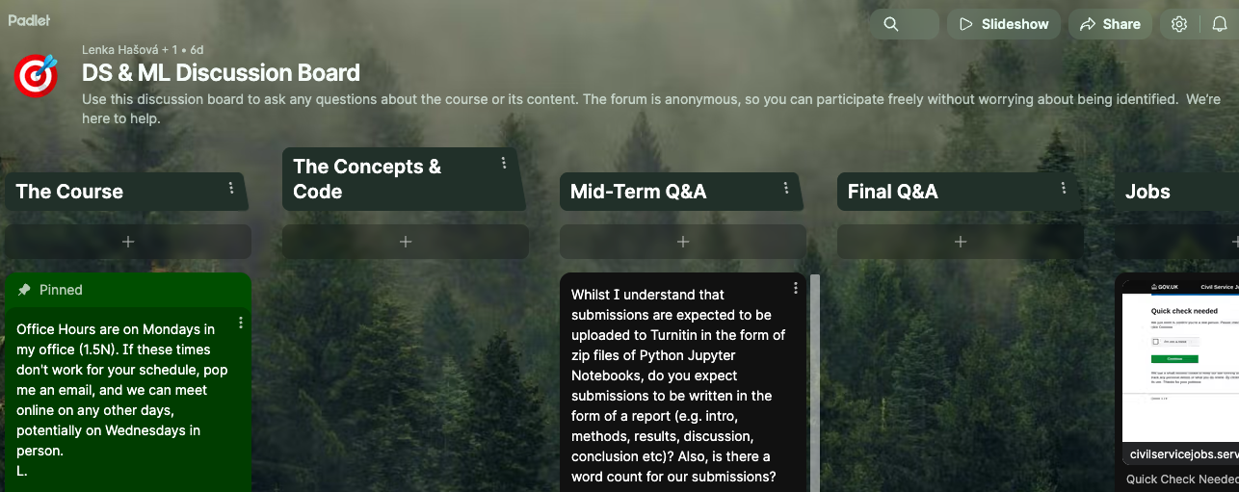
Q&A
If you remember anything later, go to the course discussion on blackboard, hosted on padlet.

Slide 8
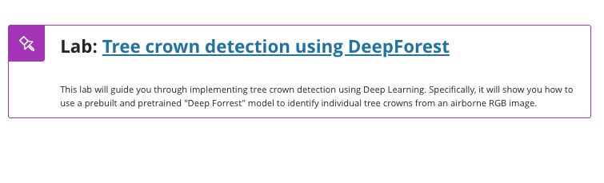
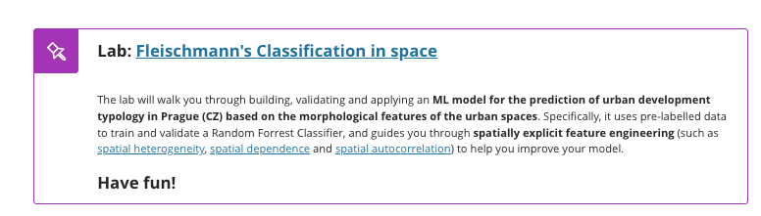
For the rest of today….and next week, in-fact

