Slide 1
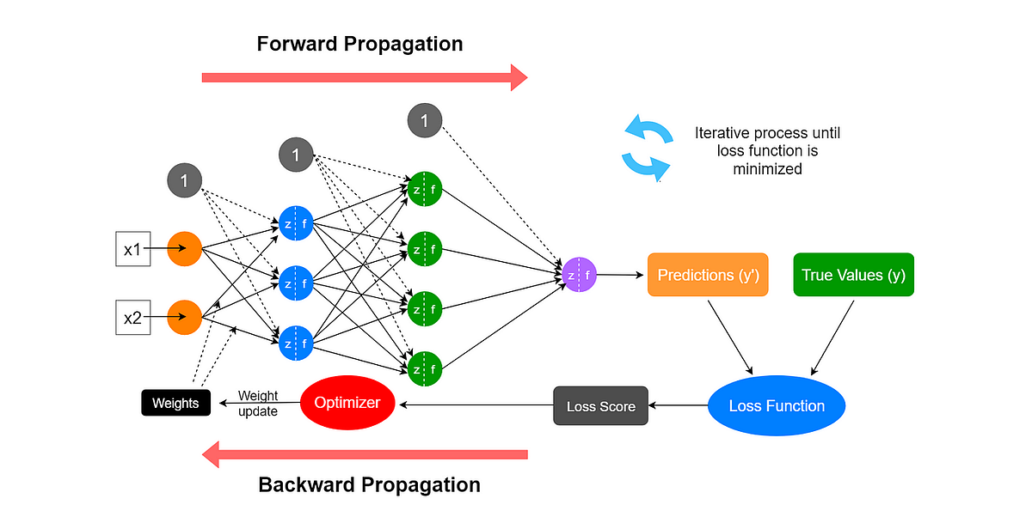
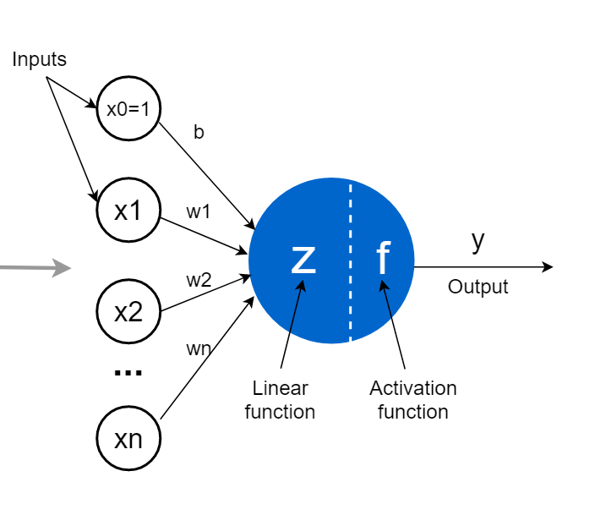
Last week’s comprehension questions

Slide 2
Data Science & Machine Learning in Geography 25/26
Deep Learning this week
Architectures
Today

Slide 3
Data Science & Machine Learning in Geography 25/26
Deep Learning this week
Architectures
Today

Slide 4
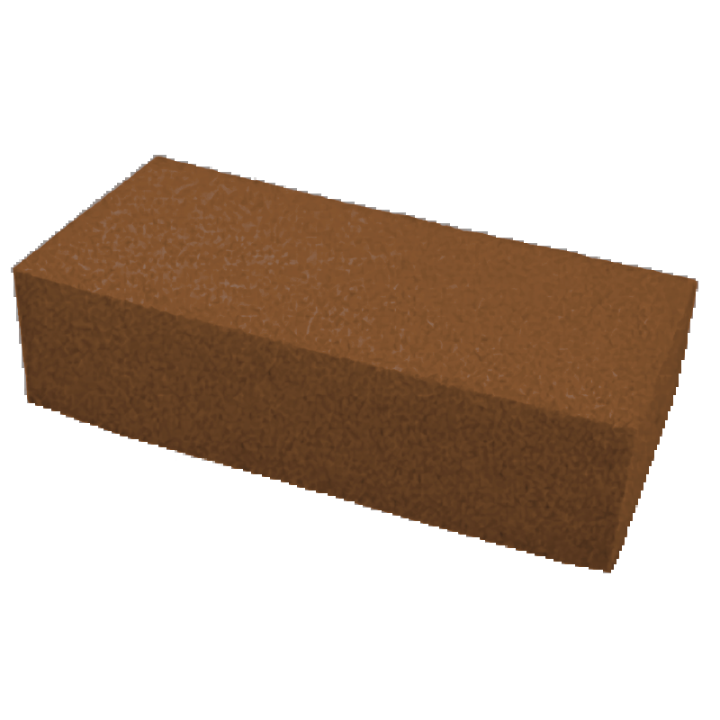
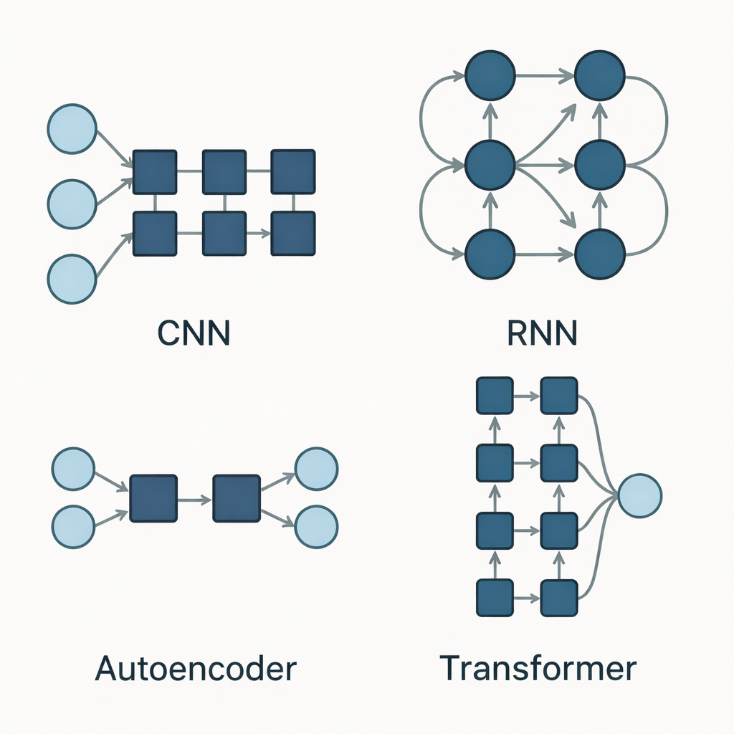
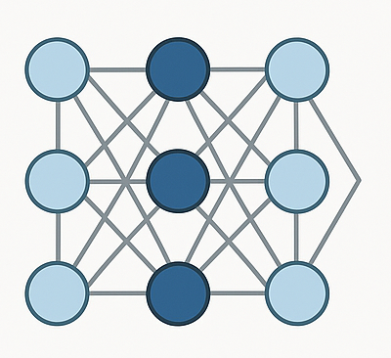
What
ANN
DNN
Fully connected

Slide 5
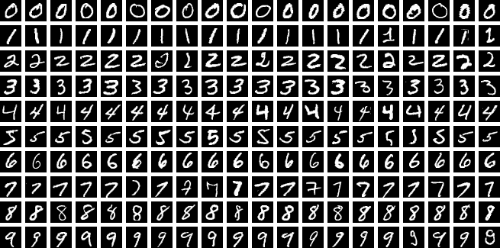
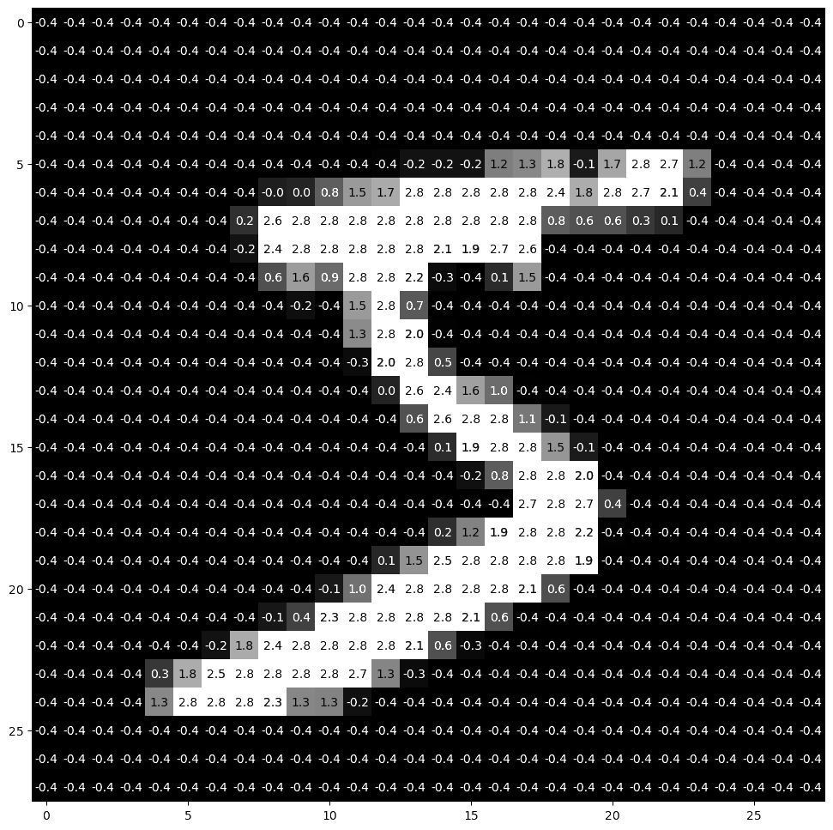
MNIST data used in explanations today

Slide 6
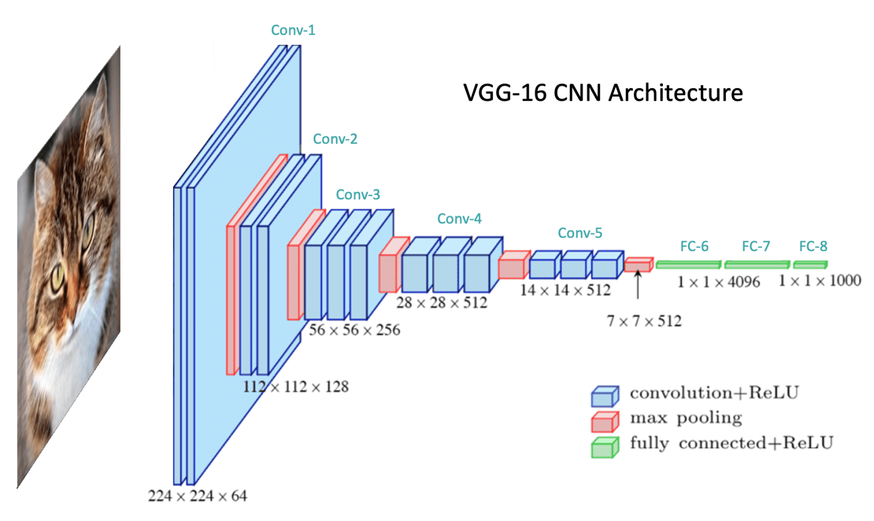
CNN - the general structure
INPUT
OUTPUT
Convolution
Convolution
Convolution
Pooling
Pooling
Flatten
Pooling
Fully connected
layer doing the classification or regression
Convolution - feature extraction layer
Pooling - data reduction layer
Flatten - collapsing the final layer into a vector

Slide 7
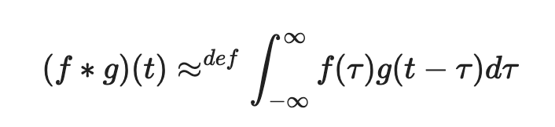
CNN - Convolution
integral that expresses the amount of overlap of one function f(t), as it is shifted over function g(t)

Slide 8
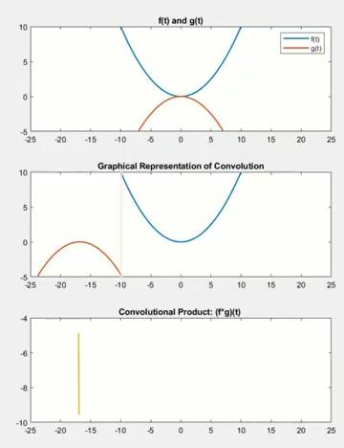
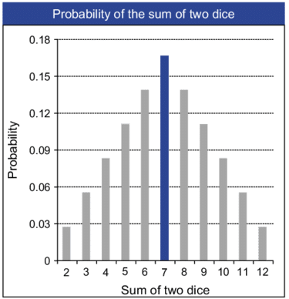
CNN - Convolution
Source
Integral that expresses the amount of overlap of one function f(t), as it is shifted over function g(t)
In other words
Adding two independent events together, what is their sum distribution (joint occurrence) looks like?
Notes:
Roll two dice
probability of each number occurring is the same
but the sum of two dice is not always the same > it has normal distribution as there is more dice combinations adding to 7 than those adding to 2

Slide 9
CNN - Convolution
Feature map
0 | 0 | 0 | 0 | 0 | 0 | 0
0 | 0 | 10 | 20 | 10 | 0 | 0
0 | 0 | 20 | 30 | 20 | 0 | 0
0 | 0 | 10 | 20 | 10 | 0 | 0
0 | 0 | 0 | 0 | 0 | 0 | 0
=
SUM
*
-1 | 0 | +1
-1 | 0 | +1
-1 | 0 | +1
0 | 0 | 0
0 | 0 | 10
0 | 0 | 20
30 | 50 | 0 | -50 | -30
40 | 70 | 0 | -70 | -40
30 | 50 | 0 | -50 | -30
Filter/kernel
stride = 1
detecting right edges
-10 | 0 | 0
-20 | 0 | 0
-10 | 0 | 0
Padded feature map
0 | 0 | 0 | 0 | 0 | 0 | 0
0 | 30 | 50 | 0 | -50 | -30 | 0
0 | 40 | 70 | 0 | -70 | -40 | 0
0 | 30 | 50 | 0 | -50 | -30 | 0
0 | 0 | 0 | 0 | 0 | 0 | 0
Feature extractor
Moving window/moving average also called filter or kernel
Parameters
  Stride - how many pixels the window jumps “over”
  Filter/kernel size
  Padding- yes or no

Slide 10
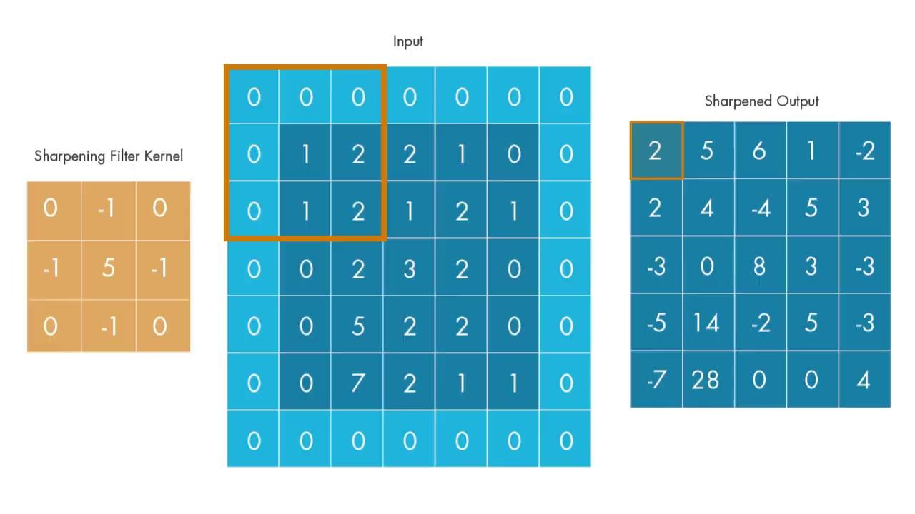
CNN - Convolution

Slide 11
CNN - Convolution
ReLU
b +
w | w | w
w | w | w
w | w | w
1 kernel = 1 neuron
Feature map
INPUT
w | w | w
w | w | w
w | w | w
ReLU
b +
ReLU b +
30 | 50 | 0 | -50 | -30
40 | 70 | 0 | -70 | -40
30 | 50 | 0 | -50 | -30
AF b +
w | w | w
w | w | w
w | w | w
ReLU
b +
w | w | w
w | w | w
w | w | w
Parameters
  Stride
  Filter/kernel size
  Padding- yes or no
  Bias
  Activation function
ReLU
b +
w | w | w
w | w | w
w | w | w

Slide 12
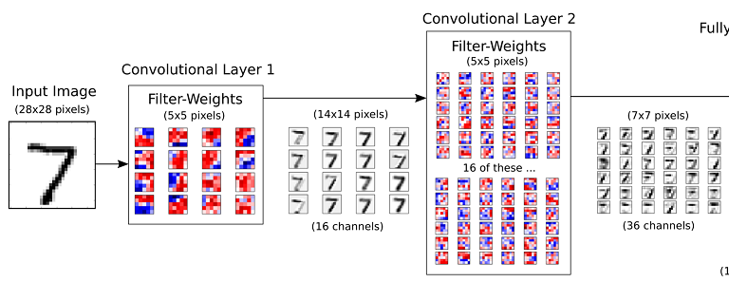
CNN - Convolution
-1 | 0 | +1
-1 | 0 | +1
-1 | 0 | +1
-1.8 | 0.8 | +2.1
-1.5 | 0.5 | +1.4
-1 | 0 | +1
Filters in first C-layer are simpler and there is generally less of them
Parameters
Number of filters
Number of layers
Filters in second C-layer are more complex and the double in size

Slide 13
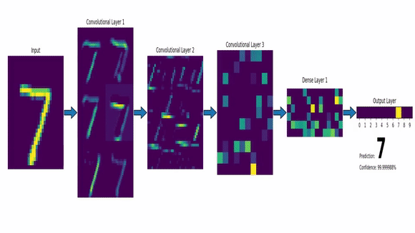
CNN - Convolution
Detecting spatial relations hierarchically
for one 28x28 MNIST image:
> to cover one image, 3x3 filter needs to change its position 676 times (676 neurons)
> start with 32 filters, 676x32=21,623 neurons
There 70,000 images in the data > 1,514,240,000
For MINST data we need 1,5 billion neurons/operations in the first layer

Slide 14
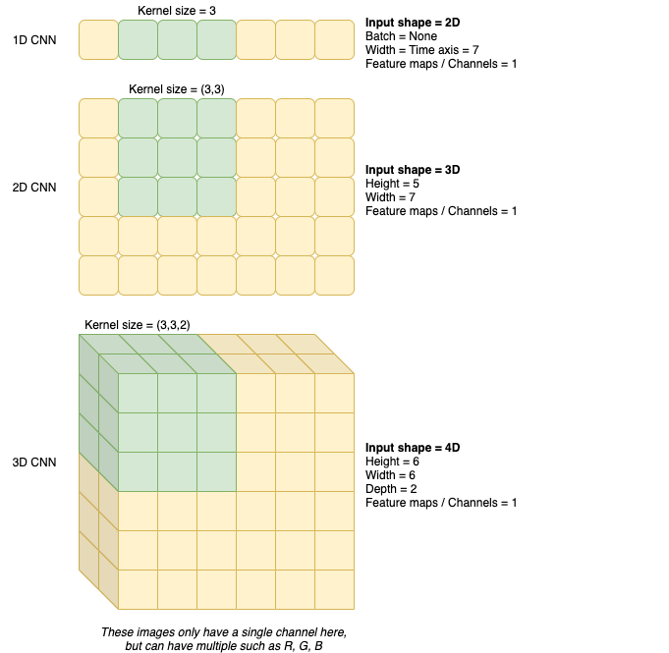
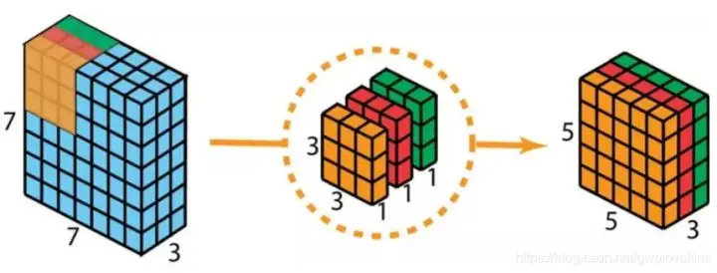
CNN - Convolution
Audio processing
Single-layer image
Multi-layer image
RGB
RGB feature map
RGB filter

Slide 15
CNN - the general structure
INPUT
OUTPUT
Convolution
Convolution
Convolution
Pooling
Pooling
Flatten
Pooling
Fully connected
layer doing the classification or regression
Convolution - feature extraction layer
Pooling - data reduction layer
Flatten - collapsing the final layer into a vector
Watch the whole process here

Slide 16
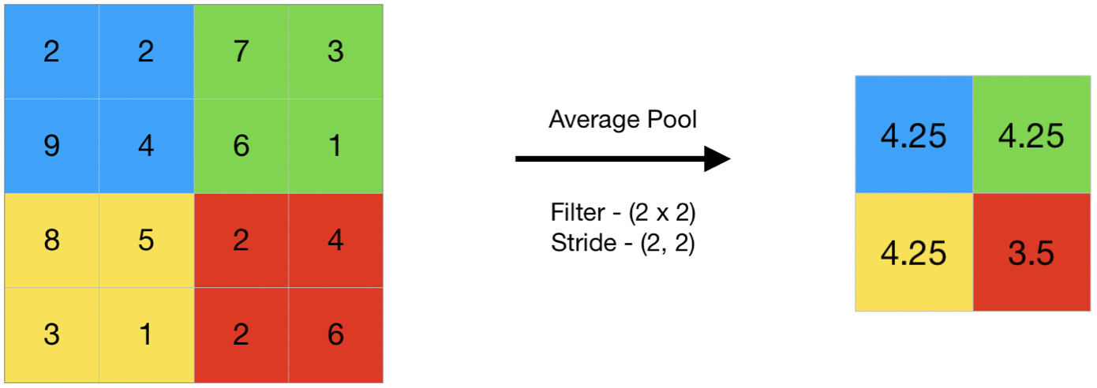
CNN - Pooling
Also called subsampling / aggregation / reduction
Reducing the size of the image by aggregating numbers within set windows
The aggregation
  MAX - MaxPool (preserving the most prominent features in the window)
  MIN
  AVERAGE
Parameters
pooling type

Slide 17
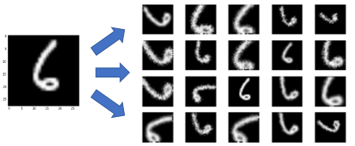
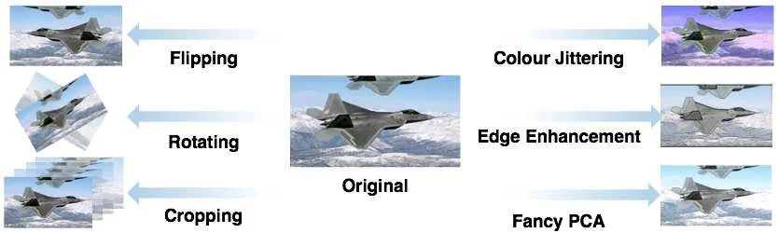
CNN - keep in mind
Data augmentation
Need data
No understanding of rotation
Hard to interpret
the more layers the more of the ‘global’ we learn on a top of the ‘local’

Slide 18
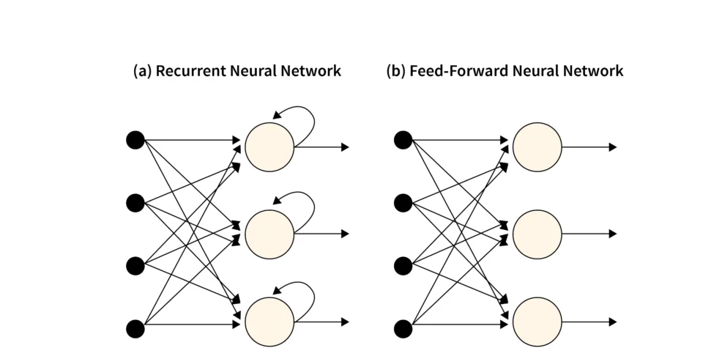
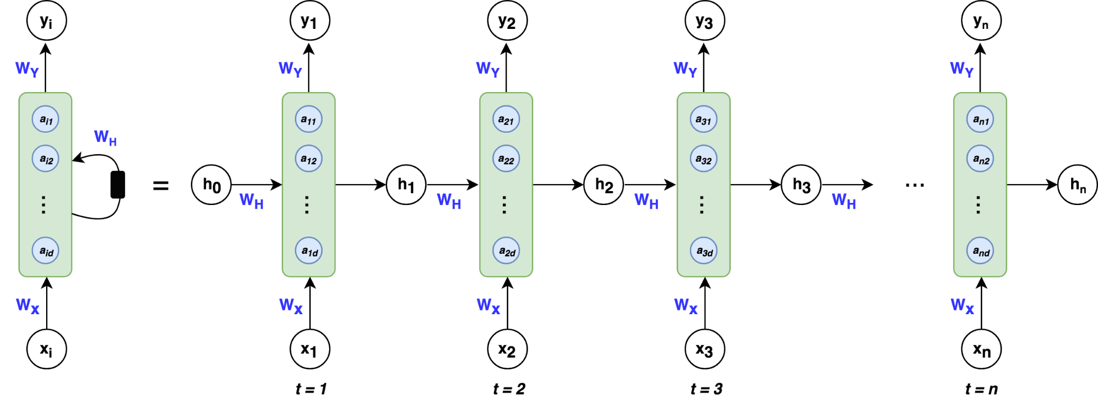
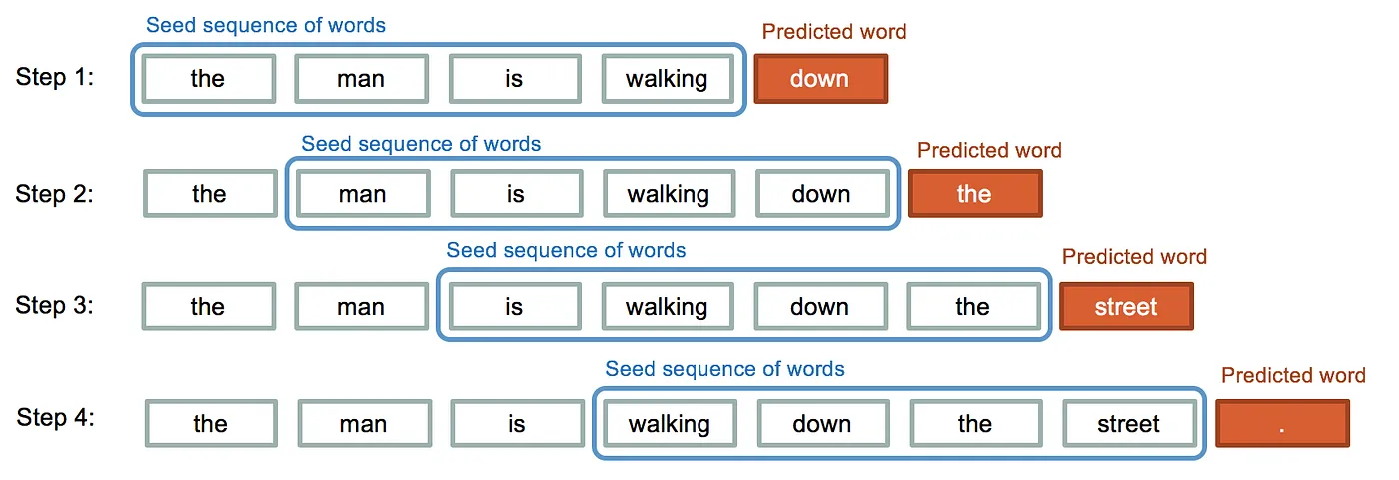
RNN - Recurrent Neural Network
Neurons with Recurrence > It applies a recurrence relation in every time step to process a sequence
Used for any sequenced data
  Temporal data & time series
  Sentiment analysis
  Text generation
  Translation
  Speech recognition
  Music generation

Slide 19
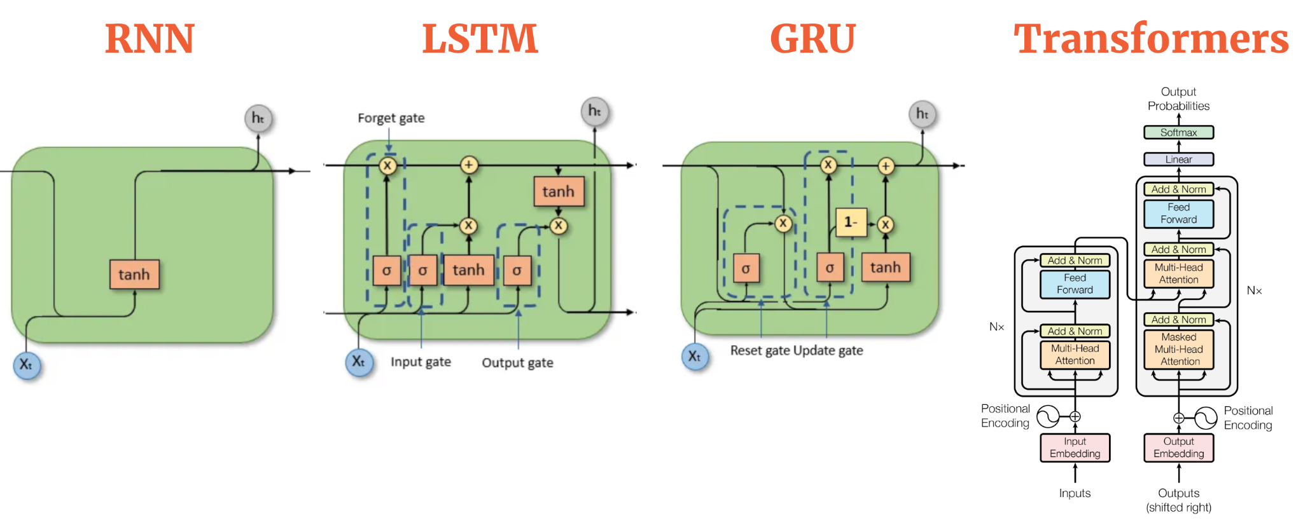
The next step from RNN
RNN
1986
LSTM
1997
Transformer
2017
Introduces recurrence
one step at the time
slow
memory fades over distance
mostly not used today
can pass two steps at once
still slow
‘Gate’ decides which memory stays and which is not needed
sometimes still used
can pass whole sequences at once
“attention” replaces memory
LLMs and NLPs today

Slide 20
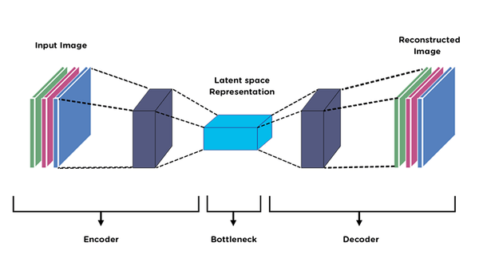
Honorable mentions > Autoencoders
Autoencoders are a type of neural network leveraged for unsupervised learning purposes that try to optimize a set of parameters to compress the input data into the latent space, spot patterns and anomalies, and improve comprehension of the behavior of the data as a whole.
Because the middle layer is smaller than the input, the network is forced to learn the most important features of the data.

Slide 21

Reading and comprehension
Reading: ISL 10.3
Lab: ISL 10.9.3
Comprehension: 10.10.4, 10.10.8

Slide 22
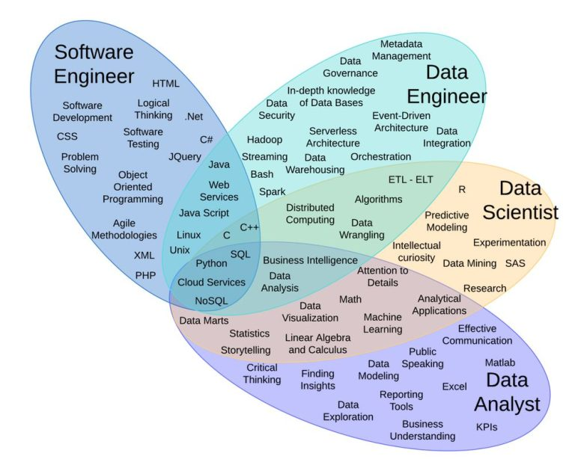
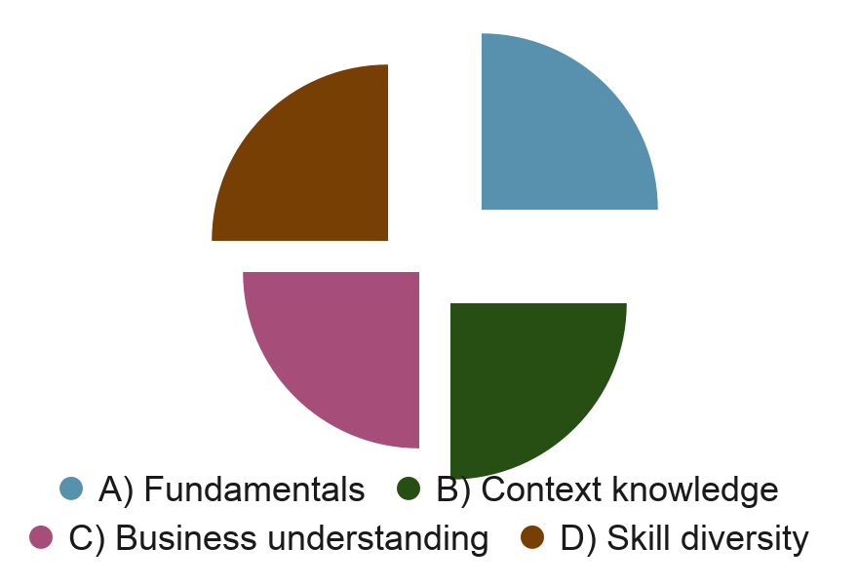
How to prepare for jobs outside academia
you after this masters
Watch the last-years Stanford career advice lecture.
Image Source

