Slide 1
Last week’s comprehension questions

Slide 2
Data Science & Machine Learning in Geography 25/26
Deep Learning this week
History & Intro
Basics of ANN
Next week
Architectures
Today

Slide 3
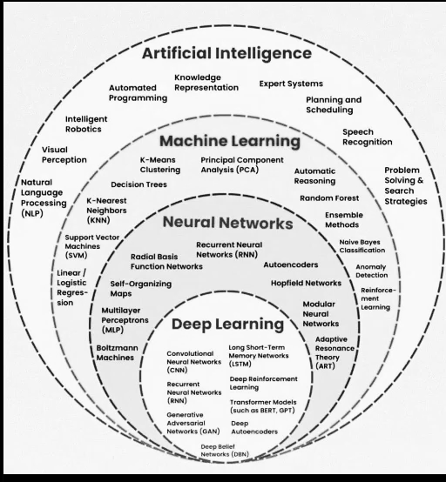
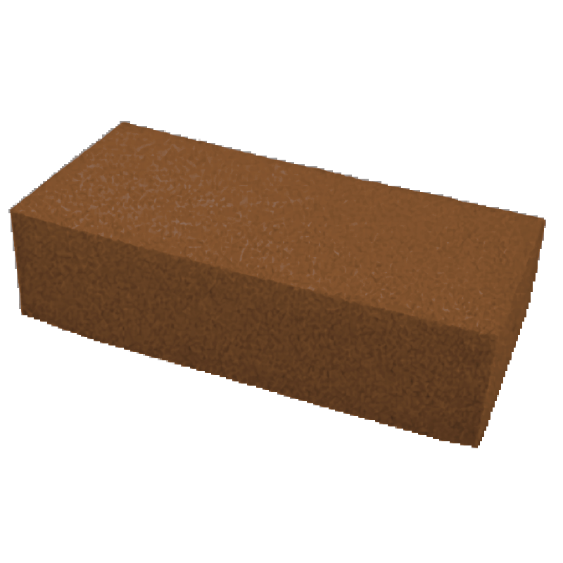
What
ANN
Image Source

Slide 4
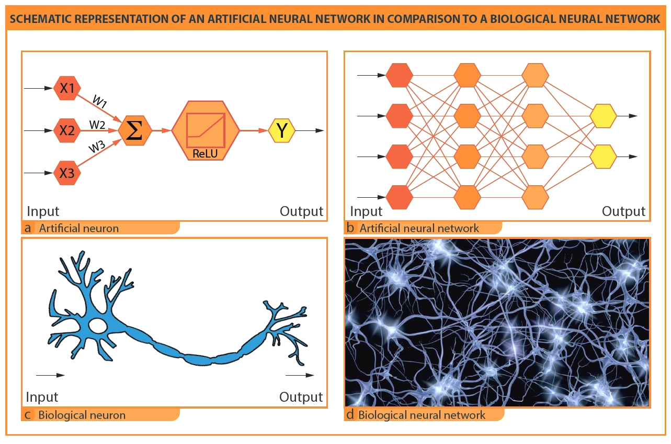
ANN
Image Source
Notes:
Neural networks are machine learning models that mimic the complex functions of the human brain

Slide 5
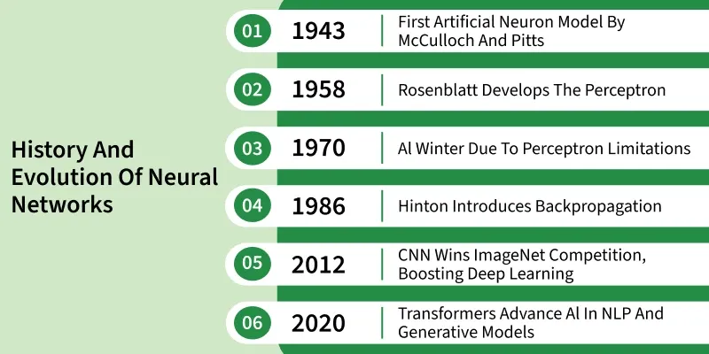
Image Source
Notes:
First idea of the use of neurons

Slide 6
ANN
The core of NN (the neuron)
The layers
The process

Slide 7
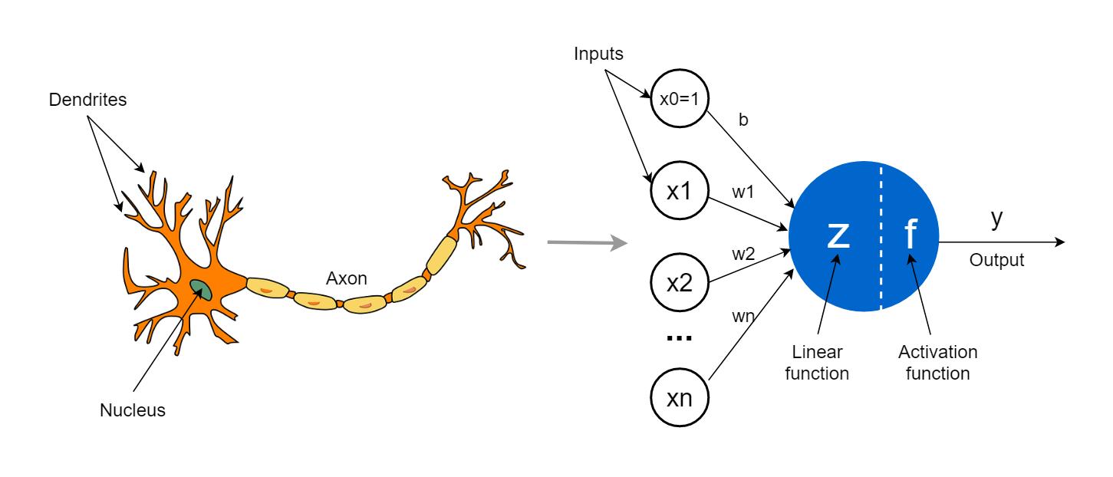
The core = neuron
Parameters
b = bias
w = weight
Notes:
bias is like an intercept and weight is like a coefficient

Slide 8
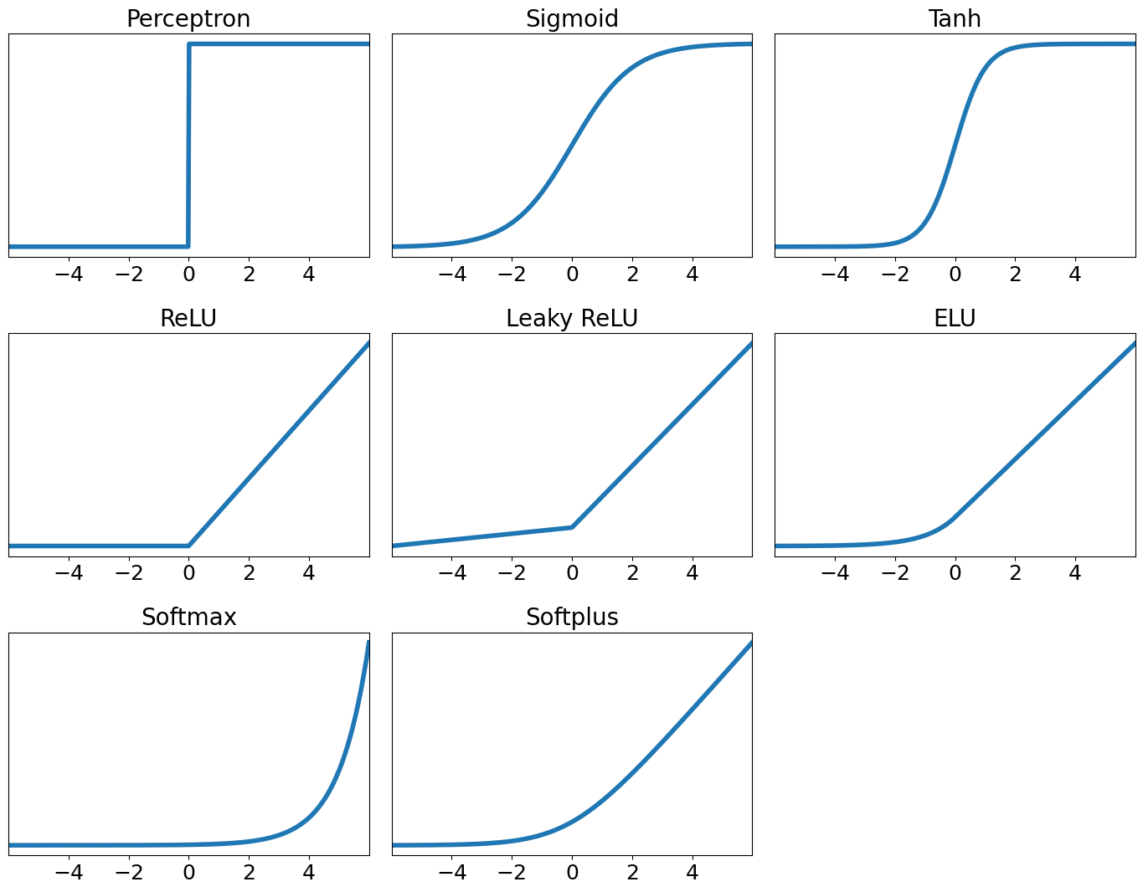

Activation functions
gives non-linearity
gatekeeper
controls the range

Slide 9
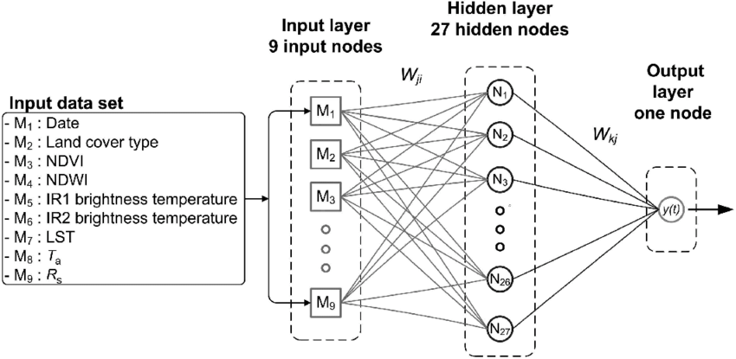
Layers
Notes:
NN is a network for reason, its not just one neuron, its layers and layers of neurons creating connected network. we are essentially stacking the layers together: each layer becomes another layer input.

Slide 10
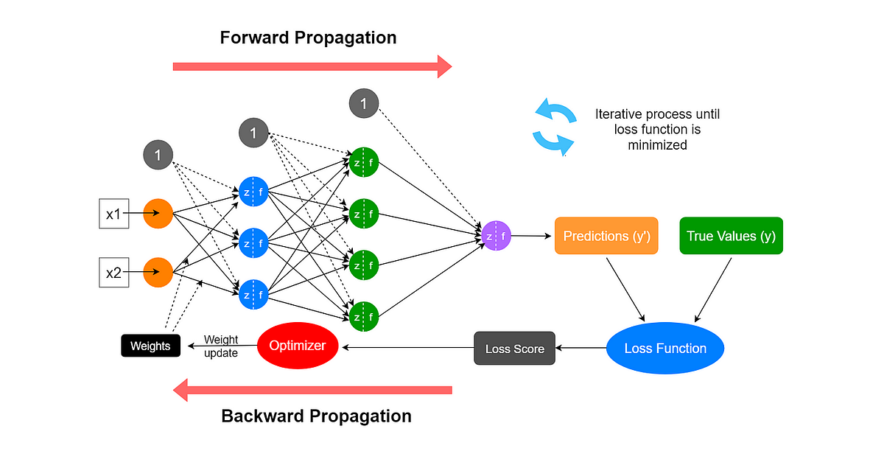
The process
Notes:
The network makes a random guess on biases and weights at the first instance, then it conducts the calculations.
Takes the prediction, calculates the errir/loss, and take that back through the network by (backpropagation).
This is a process of going back through the network redistributing the loss over the given parameters and finding which parameters are the source of the biggest error.
Based on if the error/loss for given weight is large or small and positive and negative, the network then adjust s the weight to minimize that error. This is called gradient descent: starting at random weight, try to minimize the error of that weight by gradually finding local minimum. Here is hiding another parameter of NN. the rate, or amount, with which the weight adjusts is called “learning rate”. You can adjust this, and test different rates, too small and you will be overfitting a lot and taking long time, too large and you will lose accuracy.
1 iteration through part of the data = iteration (reading one chapter)
1 iteration through all the data = 1 epoch (reading all book once)
we can define the number of iterations/epoch

Slide 11
fit win ML context
Supervised or unsupervised?
Parametric or non-parametric?
What is the core power of NN (DL)
Will it be prone to overfitting?

Slide 12
Pros and cons
Pros
Flexible & versatile
No need for feature engineering
Scales with data
Any data
Outperforms almost every other approach
Cons
Black box
Need data
Expensive
Can “explode”
Notes:
exploding = vanishing gradient point = multiplying many smallumber together can result in 0, and if weights are very close to zero, they are barely updating, then the network stops learning in those layers

Slide 13
Summary
Notes:
We talked about:
What is NN and where it came from
NN consist of neurons that receive signal, do something with it and send it forward
NN compromises linear function wrapped by non-linear function (actvation)
We stack NN into layers
Use backpropagation to improve the weights

Slide 14
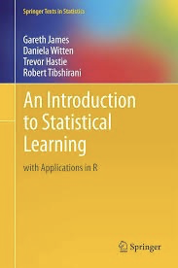
Reading and comprehension
Reading: ISL 10.1-2
Lab: ISL 10.9.1-10.9.2
Comprehension: 10.10.1, 10.10.5, 10.10.7

Slide 15
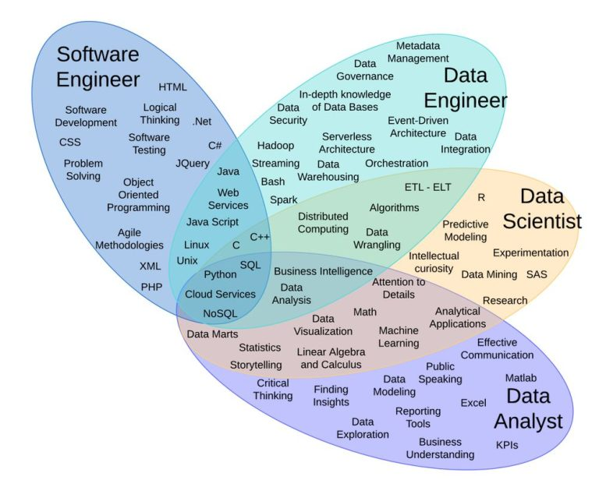
What
you after this masters
Image Source

