Slide 1
Last week’s comprehension questions

Slide 2
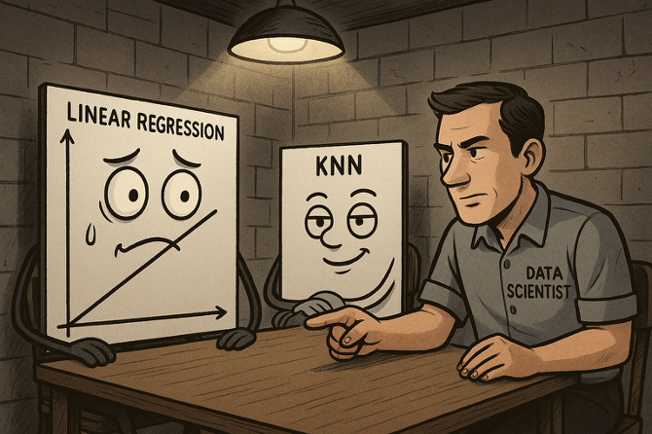
Data Science & Machine Learning in Geography 25/26
Model Criticism / Interrogation
What & Why
Main methods
The methods in details
Today

Slide 3

What & Why
Model specific way:
Model agnostic way:
Notes:
beta = the marginal effects (slopes)
p-values = the importances
residuals = bias checks and the random error investigation
r2 = model performance investigation

Slide 4
Main types
The effects
The importance
The bias
The outlier
Important

Slide 5
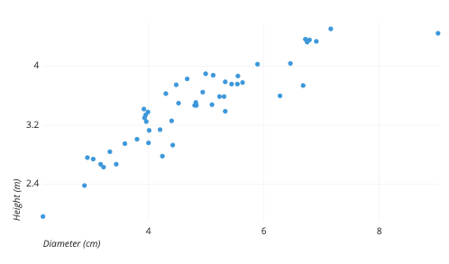
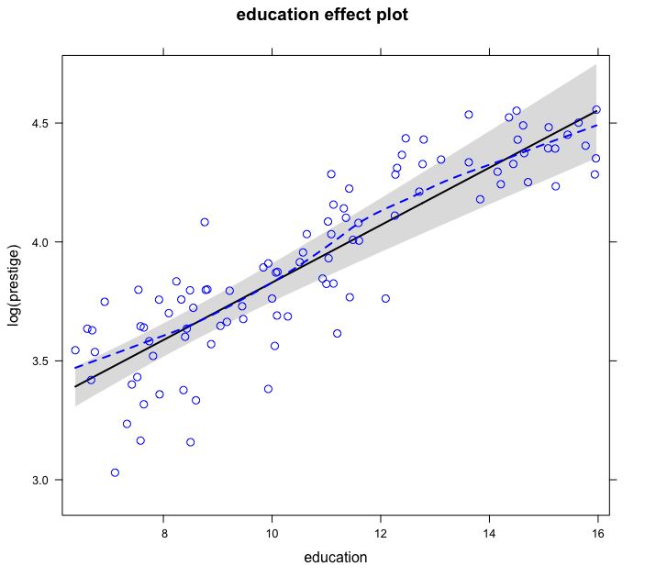
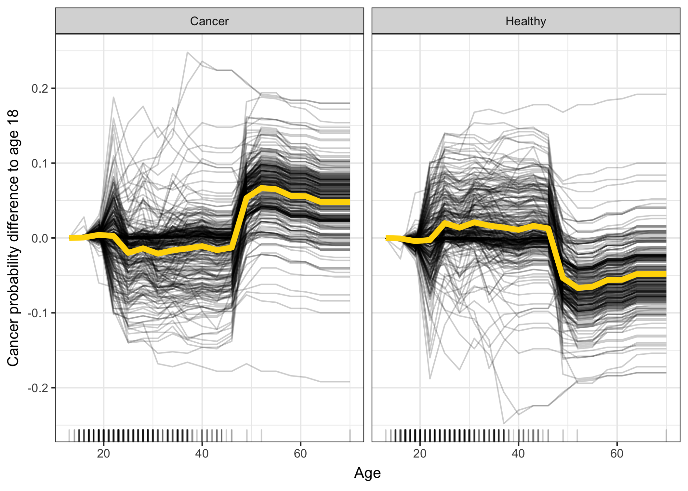

The effects
Q: How does X relate to the Y?
Scatter plots + effect plot
Partial Dependence Plots (PDP)
Individual Conditional
Expectation/Estimate (ICE) Plot
Notes:
All of these visualize the effect of a single feature on the predicted outcome of a machine learning model.
The effect plot show the effect of feature 1 while else held constant, that is for mean feature 2 and mean feature 3, feature 1 behaves ….given its range from 1:n. So what we are visualising is one observation for the whole data, and we might be visualising things that don’t exist.
This might work for regression where means of means is the general function of the equation, but for flexible models, such as knn, which does not see the data as a whole this wont work. So instead we fix the features 2-3 at each observations at look at the effect of the feature 1 at each individual observation: Individual conditional estimates: individual prediction estimates that are conditional on the observation itself.
PDP is simply an average of those lines, so at each point in x1 is the mean of all the ICEs for that pont x1. So PDP shows what the model thinks about the effect of x1 for an average observation, while generic effect plot shows what the the model thinks about the effect of x1 on average within the whole training data.

Slide 6
The effects
Q: How does X relate to the Y?
Individual Conditional Expectation/Estimate (ICE) Plot - visualizes feature estimates conditional on the individual observations
Partial Dependence Plots (PDP) = mean feature estimates for each observation set
Has Independence assumptions
3 or more features impossible to visualise
Heterogeneity may be hidden in pdp but visible in ICE
Need: Model & data already used
Intuitive & Interpretative
Easy to Implement
Can do 1 feature
Can do 2 features & detect interactions
PROS
CONS
Notes:
The assumption of independence is the biggest issue with PD plots. It is assumed that the feature(s) for which the partial dependence is computed are not correlated with other features. In other words: When the features are correlated, we create new data points in areas of the feature distribution where the actual probability is very low

Slide 7
The importance
Q: How important is X for the prediction of Y?
To permute means:
values of the new shuffled variable will be same as the values of the original
Its distribution will be the same
but the order in which the values occurs is random > destroying the relationship with Y and other X
Shuffle
Permutation Feature Importance

Slide 8
The Bias
Q: Does my model systematically mispredict?

Slide 9

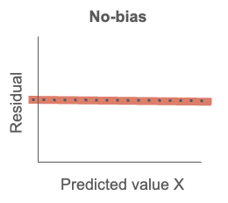
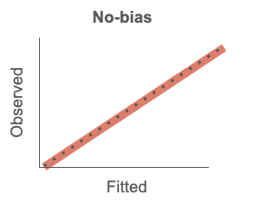
The Bias
Q: Does my model systematically mispredict?
PDPs, box plots, scatterplots residual plots…explore !

Slide 10
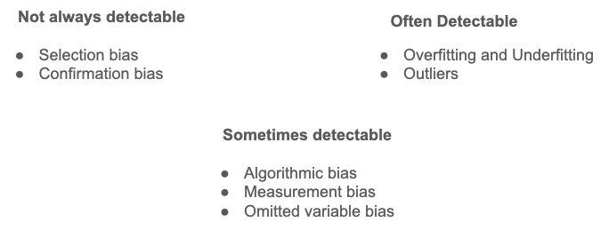

The Bias
Q: Does my model systematically mispredict?
Include omitted variables or controls (if you can)
Adjust the parameters or the function in regression
Find more complex but better fitting model
Sometimes, you can’t
  Clearly disclose the problem
  Refuse to do the exercise

Slide 11
The Outliers
Q: Is there influential observation that makes my model worse?

Slide 12
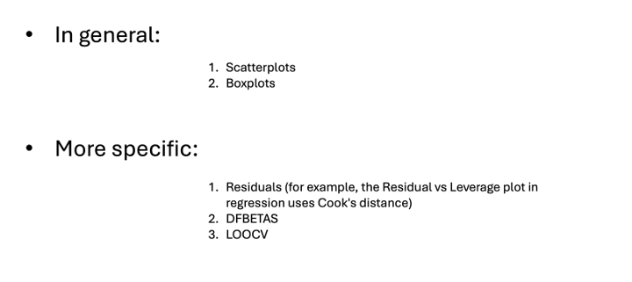
The Outliers
Q: Is there influential observation that makes my model worse?
Notes:
But remember:
Outliers are not so common in ML
Ask why do they exists
Have a domain knowledge
Think about what drobbing outlier means

Slide 13
Summary
The effects - effect plots, PDPs ICEs
The importance - PFIs
The bias - Investigate through residuals, fix if possible
The outlier - Unlikely, if so question it

Slide 14

Reading and comprehension
Reading:
Model criticism lab
Comprehension:
Lab:

Slide 15
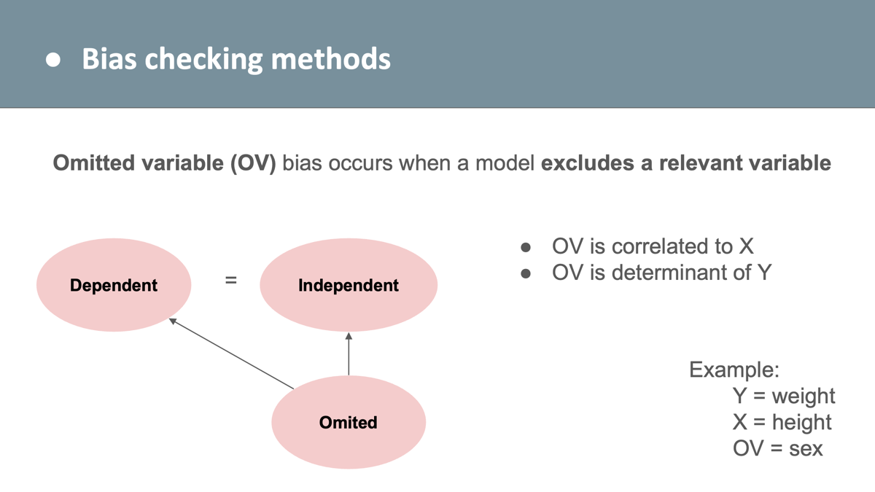

Slide 16
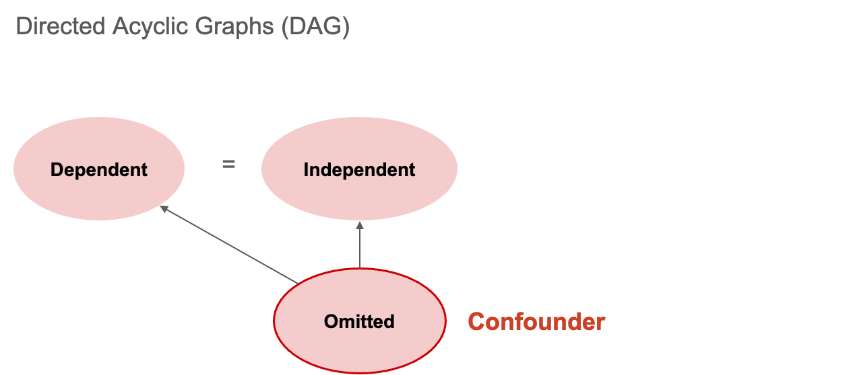

Slide 17
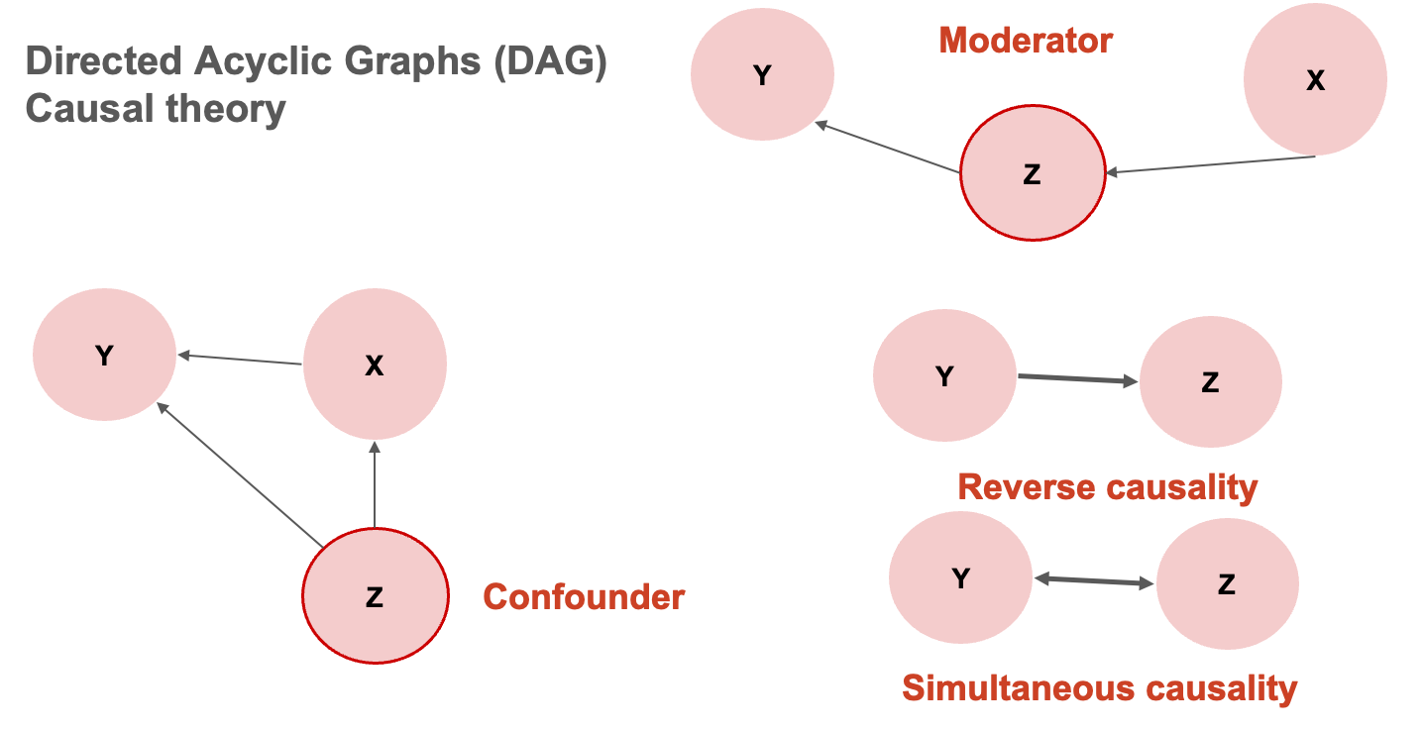

Slide 18
