Slide 1
Last week’s comprehension questions

Slide 2

Data Science & Machine Learning in Geography 25/26
Trees
Ensambles intro
Bagging
Decision trees
Random Forests
Today

Slide 3
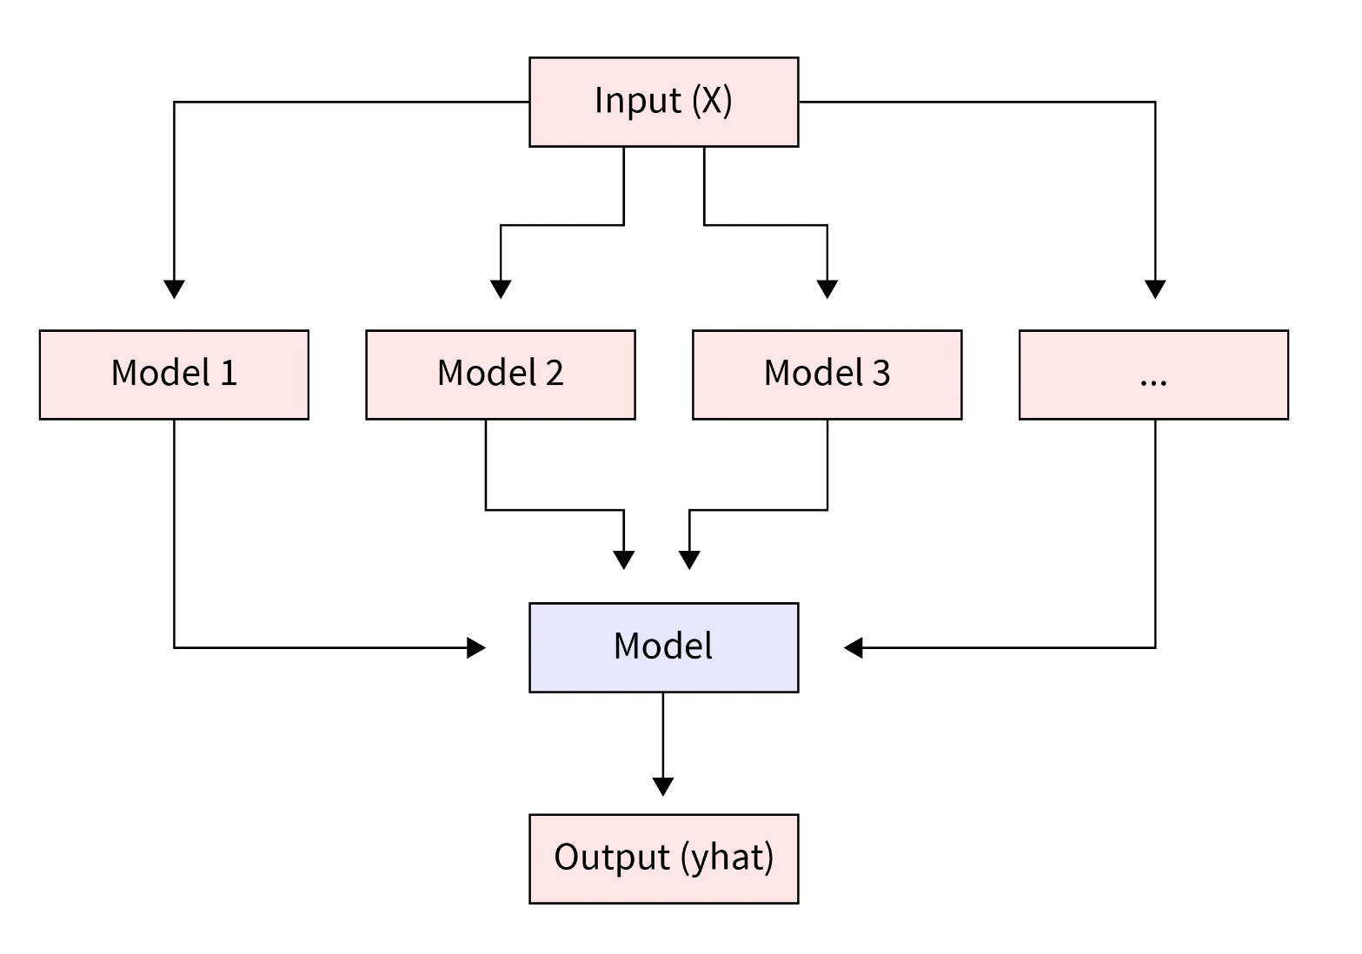
Ensembles
Using multiple models to inform the final model
(in other words, aggregating predictions of collection of models)
use easy “weak” models to build stronger prediction
based on wisdom of the crowds
both classifier or regressors
Data
Base learner
Collective information to enter the final stage
Notes:
leveraging the collective intelligence of diverse models, they improve generalization, reduce variance, and minimize error compared to a single estimator

Slide 4
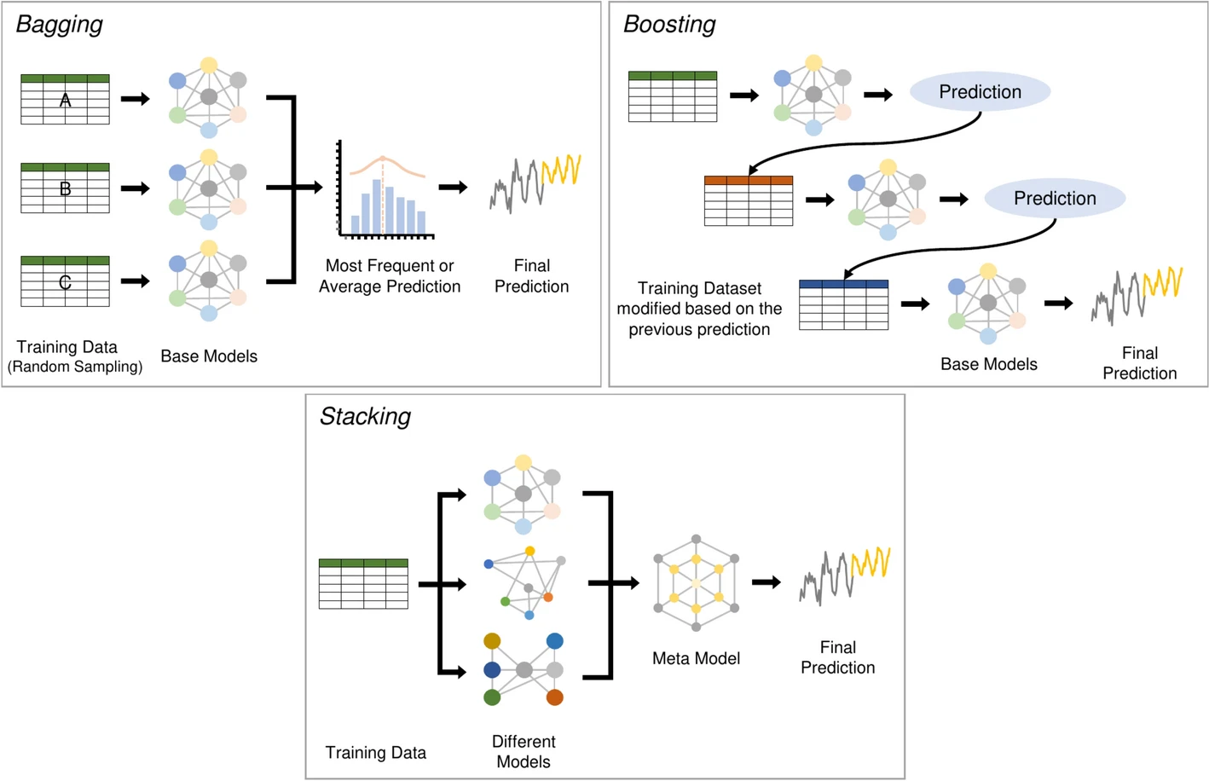
3 options
Bagging
parallel, independent
Boosting
sequential, learn from past errors
Average
Stacking
parallel, independent,
but different models
(Voting)
parallel, independent,
but different models
take an average vote instead of creating a new model
Model
source
Notes:
Bagging
Trains multiple models independently using different random samples of the data.
Final prediction is made by averaging or voting across models.
Helps reduce overfitting and improves stability.
Boosting
Trains models sequentially, where each new model focuses on correcting errors from the previous one.
Misclassified examples get more attention over time.
Improves accuracy and reduces bias.
Stacking
Combines different types of models and uses another model (meta-model) to make the final prediction.
The meta-model learns how to best combine the individual model outputs.

Slide 5
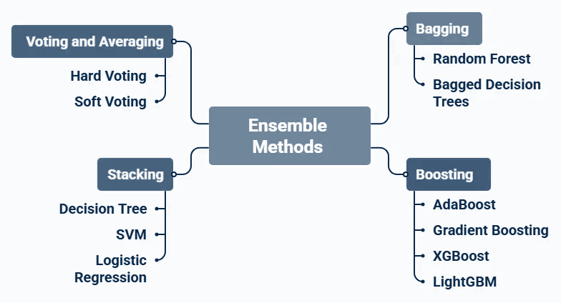
Ensembles
Used in:
Finance
  credit scoring
Cybersecurity
  anomaly, attack detection
Healthcare
  disease, outcome prediction
E-commerce
  product recommendation
Manufacturing
  detect defective product
Environmental sci.
  air pollution prediction, flood level prediction, climate change impact

Slide 6
Random forest
Decision trees
Forests are a collection of decision trees = an ensemble learner
A non-parametric supervised method that
uses segmentation/stratification of data for prediction,
where each split is a rule-based decision.
Notes:
We are forcing to tree to pay attention to a random set of features at each split

Slide 7
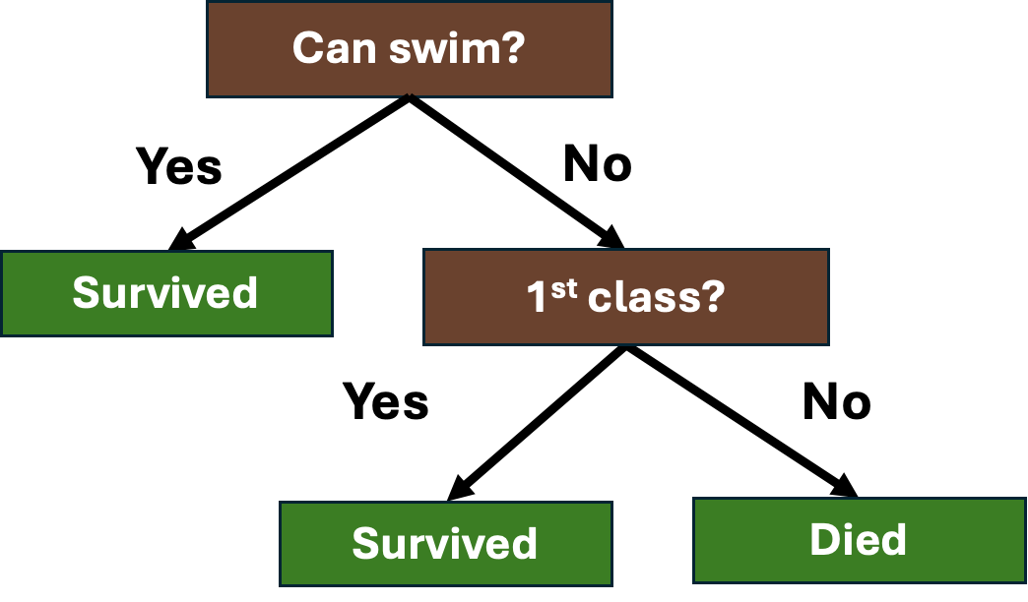
Decision trees
A non-parametric supervised method that
uses segmentation/stratification of data for prediction,
where each split is a rule-based decision.
Who survived titanic?
The goal is to split data into homogenous groups
i.e. what is the value of X that allows me to split the data into two groups so I can predict the average Y

Slide 8
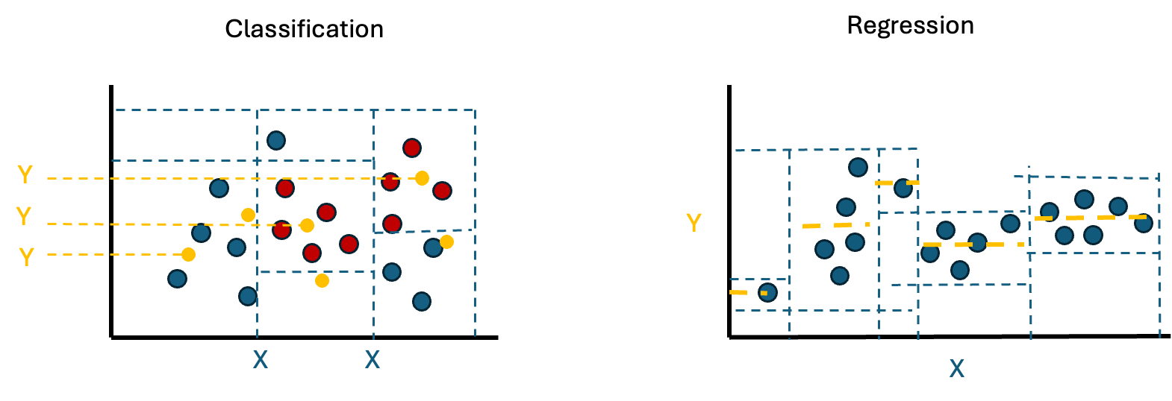
Decision trees
The goal is to split data into homogenous groups = recursive binary splitting (top-down)
i.e. what is the value of X that allows me to split the data into two groups so I can predict the average Y

Slide 9

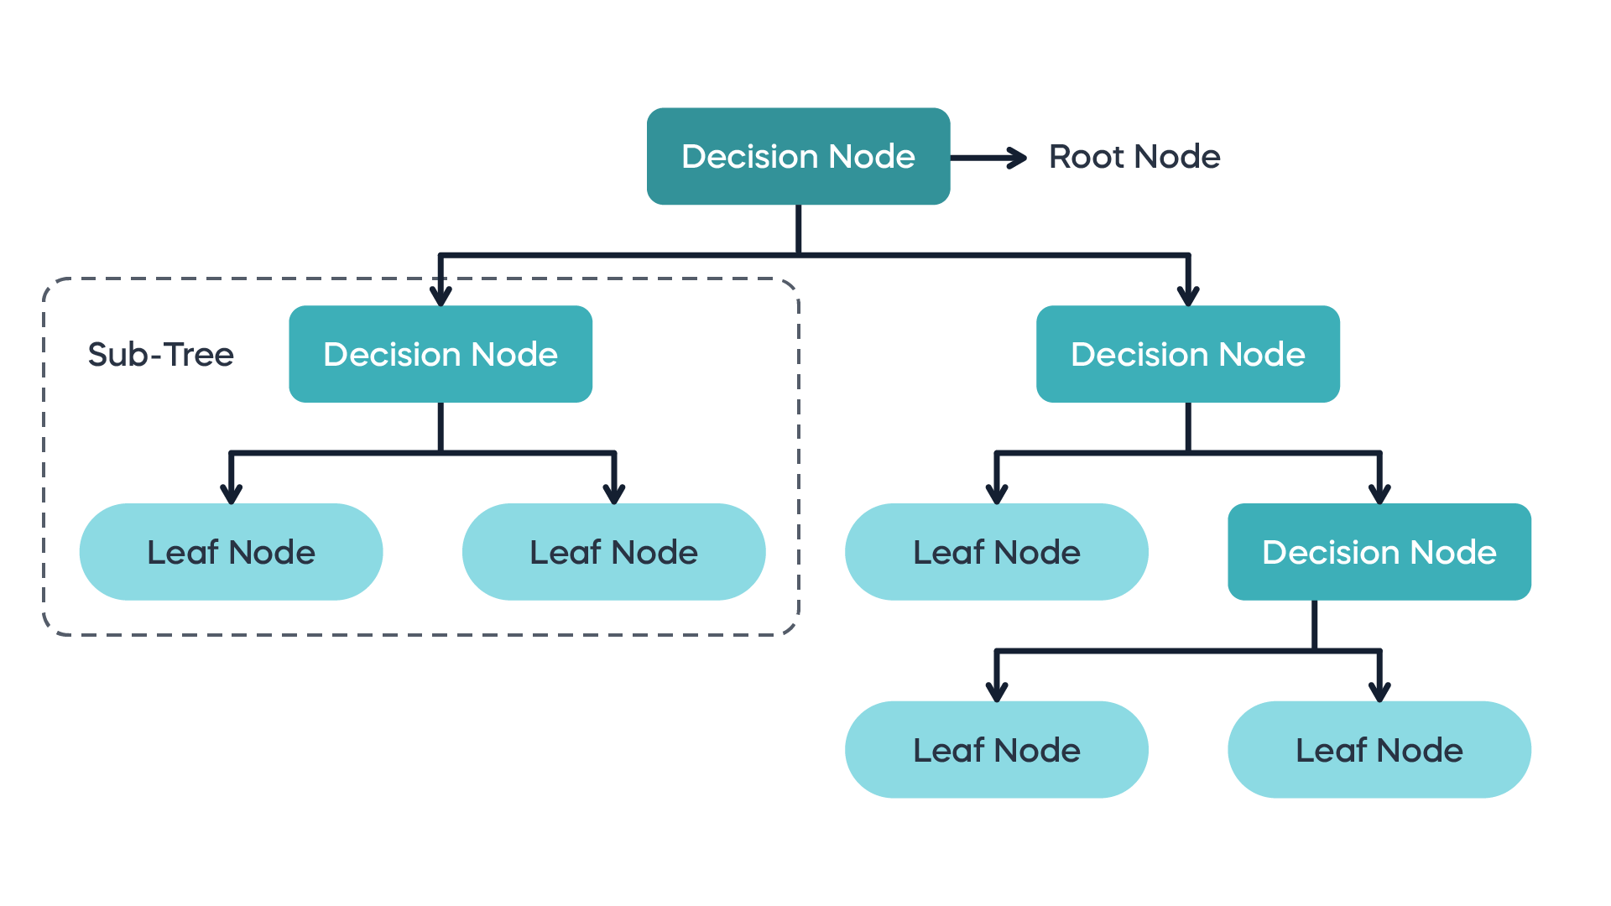
Anatomy
Decision tree flexibility is based on:
its depth
size of the leaves
complexity (cp)
Internal node
Adjusting the branches/leaf = pruning
Terminal or
external node
Notes:
complexity (cp) = threshold for how much gain has to be obtained by the split. The smaller it is the more complex/more splits the tree is going to make. It prevents overfitting by penalising the model for more splits In other words: If adding a new branch does not reduce the error by at least the value of $CP$, that branch is not created or is "pruned" away. This is an error management technique.

Slide 10

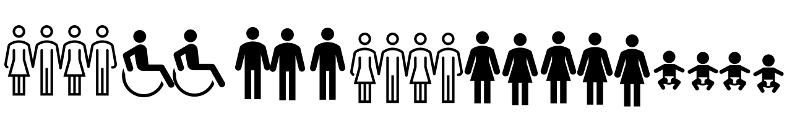
Random forest
Forests are a collection of decision trees = an ensemble learner
Random Forests are a collection of decision trees that have forced different perspectives
we could say it creates a bootstrapped sample of the data in each split
Notes:
We are forcing to tree to pay attention to a random set of features at each split and we can set how many features it will see.
Forest:
a.Flexible learner
b.Easy to interpret
c.Watch out for overfitting due to high variance
Random forests
a.Averaging many weak but uncorrelated decision trees
b.Reduces variance - variance reduction machine
c.Can be interpreted in probabilities – finding common structure/important features

Slide 11
Feature importance
A measure of how much each feature contributes to the model’s prediction accuracy. Almost like looking at the regression coefficients.
Rank which feature appears at which split in each tree
Summarise the ranking
1st
2nd
n-th
…..
…..

Slide 12
Random forest
Pros
Does no require pre-processing
handles non-linearities well
Very interpretable
RF are robust and can handle outliers and data changes
Very good resource-to-value trade-off
Cons
Individual trees are susceptible to changes and not robust
Interpretability lowers with complexity
Can have a high memory usage

Slide 13
Summary
Ensembles utilize collection of models to arrive to better outcome
There is bagging, boosting, stacking (and voting)
Random Forest is the most commonly used ML technique utilising bagging
Random Forest consist of many Decision Trees and is inspired by the Wisdom of the Crowds
Decision Tree is a recursive binary splitting algorithm

Slide 14
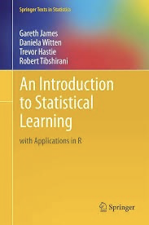
Reading and comprehension
Reading: Chapter 8.1-8.2.3
Comprehension: 8.4.1, 8.4.4, 8.4.10
Lab: ISL 8.3.1 - 8.3.4

