Slide 1
Last week’s comprehension questions

Slide 2
Data Science & Machine Learning in Geography 25/26
Resampling
Overview
Types
Application
Today

Slide 3
Overview
Cross-validation
Bootstrap
Resampling
Used for
Model selection
Model validation
Cross-validation methods
Validation Set Approach
K-Fold
LOOCV

Slide 4
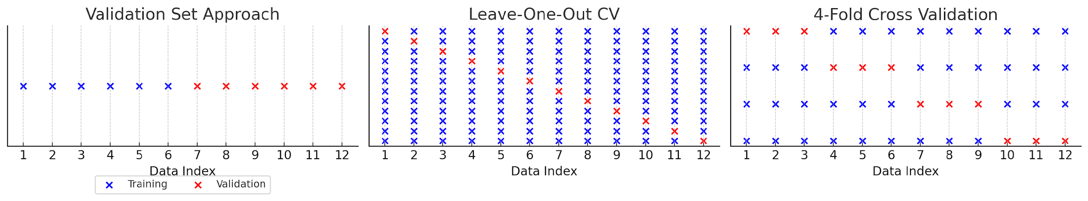
Cross - validation
Split the data into
a train set and
a test set
at random
Train–test split
  50/50
  60/40
  70/30
  80/20

Slide 5
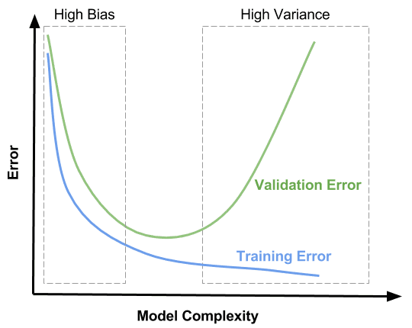
Bias variance tradeoff
Training vs Testing performance with error rate (also Cp, AIC, BIC)
Improving the model fit & prediction
Not improving anymore, but adding noise
Notes:
The more complex the model the lower the training error is. We are constantly improving our data fit on training data.
Test error decreases initially with model complexity, but eventually will reverse and increases as it overfits the data. We are improving model until we are not anymore. At some point we have already fit in most of the important features and we start adding noise into the model to capture the data, but this noise becomes detrimental when predicting for new data.
AIC estimates the relative amount of information lost by a given model.
Unexplained variation in the dependent variable and the number of explanatory variables increase the value of BIC.

Slide 6
Cross - validation
K-fold
Split the data into k-folds (k-equal parts)
Notes:
Widely used
5-10 folds are good choices. If you increase 5-6, the amount of observations in the initial fold will be little different than if you would choose 10.
Observe both, the separate MSEs (Lets you know how much the model accuracy changes with the different data as well as the average MSE.

Slide 7
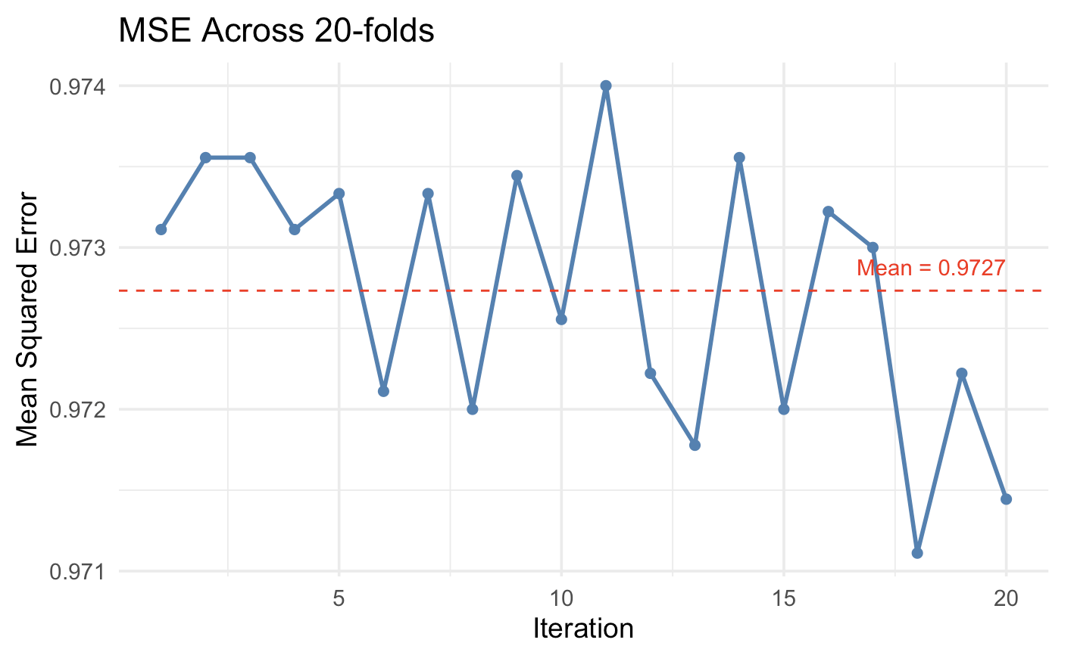
Find the best model
Notes:
After the cross-validation, you then re-train your model one last time on the entire dataset using the best settings from CV (hyperparameters). Here best model, closest to average MSE is at 10th iteration

Slide 8
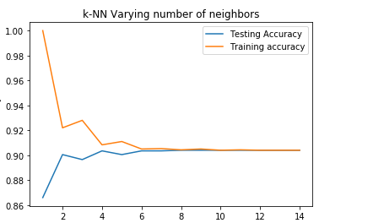
Find the best k example
Validation Set Approach 60/40 (could be k-fold) + k search (1-15)
Accuracy score
K
Notes:
Maximum test accuracy is 8, then its just constant, so we use k=8 as the parameter in our final model. But simplicity is often beter in models so choosing k = 4 or k=6 might achieve the same results (or close the same) bu uses simpler model.

Slide 9
Cross - validation
(LOOCV)
Systematically split the data into a train set
of all observations except one
and into a test set of one observation
Notes:
special case of K-fold CV
Useful

Slide 10
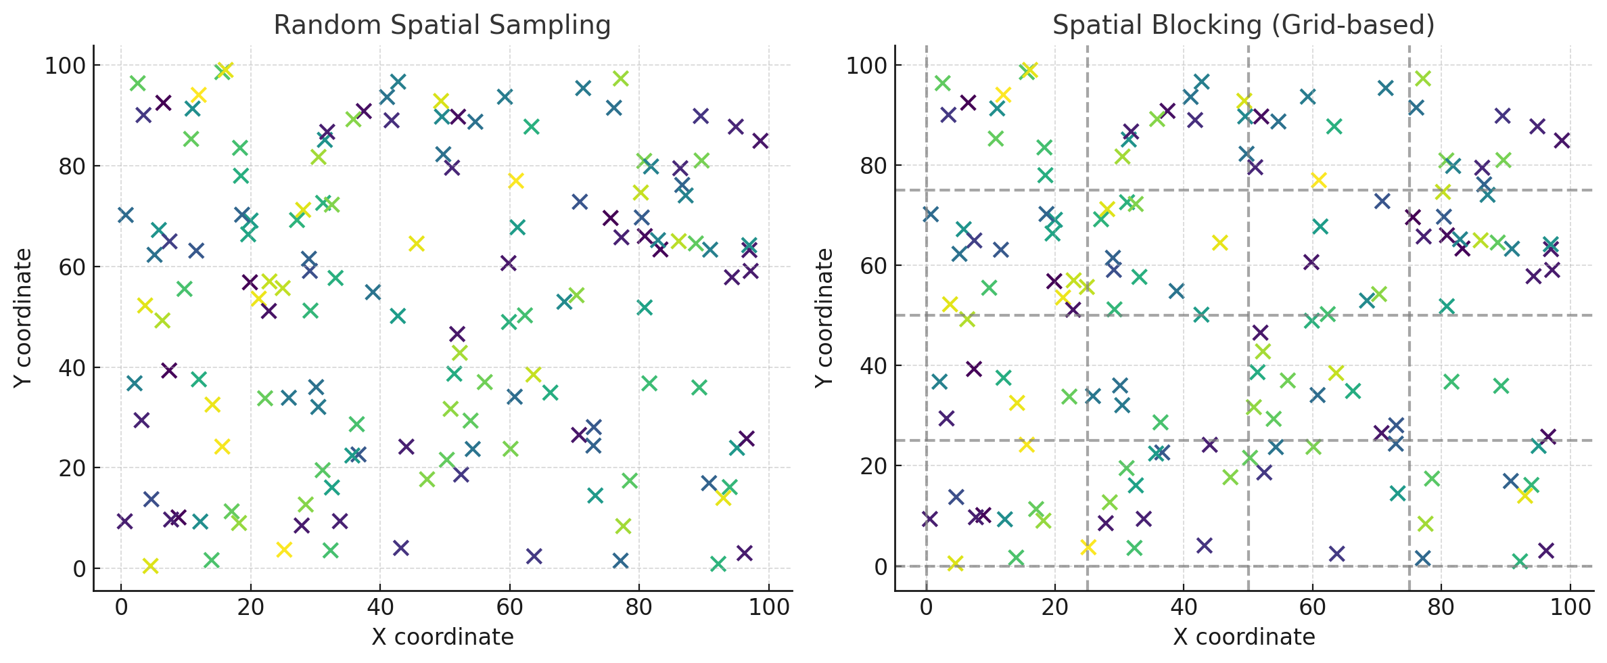
Keep in mind…
Temporal data
Back testing
One-step prediction
Time
Spatial data
Random spatial sampling
Spatial blocking

Slide 11
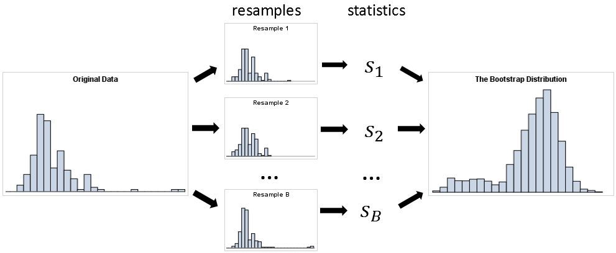
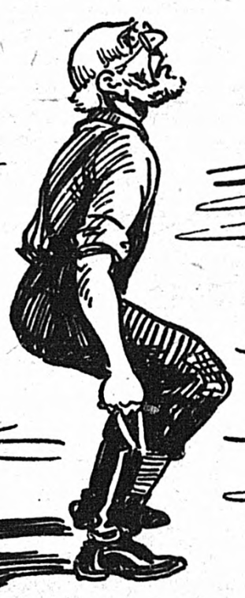
Bootstrapping
Powerful and versatile non-parametric method of resampling used for quantification of uncertainty for given estimation
Comes from “Pulling yourself up by your bootstraps”; achieving something big through personal effort alone
Notes:
The bootstrapped sample, it will retail all the properties of the original data, unless it breaks the IID assumption, don’t have enough data, or contains one massive outlier

Slide 12
Bootstrapping
With replacement
each observation can be used multiple times
observations are independent of each other
can draw big samples
Without replacement
each observation can only be used once
technically this is k-fold (k-sample) cross-validation

Slide 13
Bootstrapping - use
Make a bootstrap data (X random samples)
Estimate something (mean, make a model, …)
Keep track of the estimates
It acts as a substitute for parametric tests to determine if results are statistically significant.
assess uncertainty around our complex estimates (for example confidence intervals, ratios,..)
…
…

Slide 14
Summary
Cross-validation is an method of splitting data that can be used for both model validation & selection
hold-out method is used in DS naturally for model selection, but K-fold is often a default
Bootstrapping is repurposing the data to create random samples aiding in our estimation certainty

Slide 15
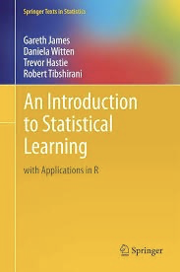
Reading and comprehension
Reading: Chapter 5
Comprehension: 5.4.3, 5.4.5, 5.4.9
Lab: ISL 5 lab (section 5.3)

