Slide 1
Last week’s comprehension questions

Slide 2
Data Science & Machine Learning in Geography 25/26
Classification
Using regression …yes we cant move on just yet!
Validation techniques
K-Nearest Neighbour Regression/Classification
Extremely Brief intro to Bayes
Today

Slide 3
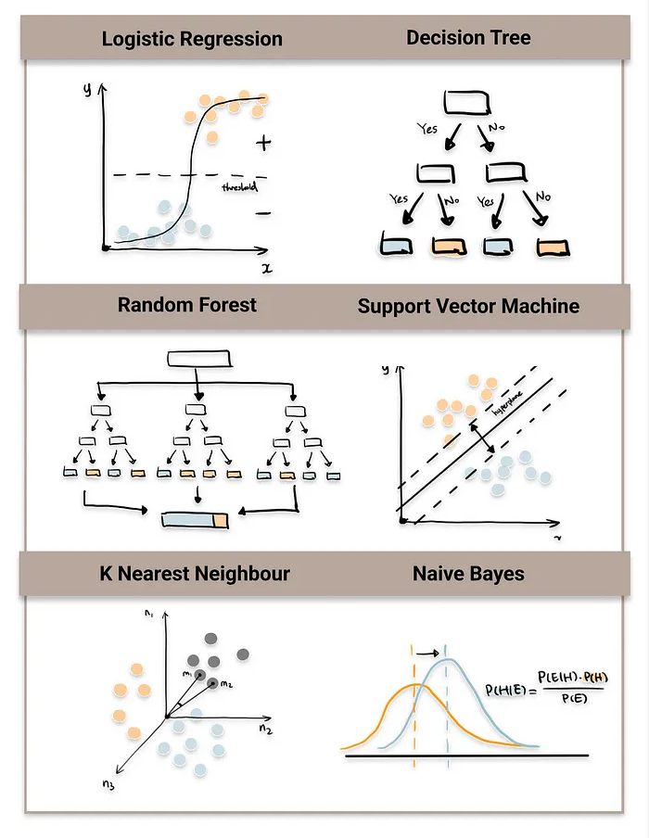
Classification
Is process of categorizing data into distinct classes or categories based on their features
Supervised technique
in scikit-learn…
 | Label | Feature 1 | Feature 2
Sample 1 | Apple | 5 | Red
Sample 1 | Pear | 3 | Orange
Source

Slide 4
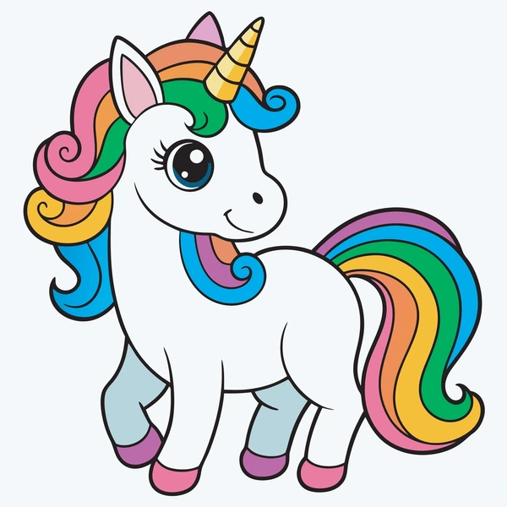
Classification
Linear classifier
Non-linear classifier
Source

Slide 5
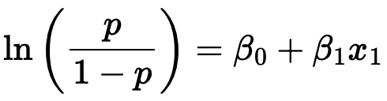
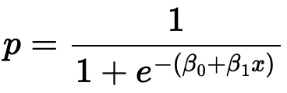
LOGISTIC REGRESSION
Log odds
Probabilities

Slide 6
Validation
Label | Predicted
0 | 0
1 | 0
0 | 1
1 | 1
Confusion matrix
 | Label Positive | Label Negative
Predicted Positive | TRUE POSITIVE | FALSE NEGATIVE
Predicted Negative | FALSE POSITIVE | TRUE NEGATIVE

Slide 7




Confusion matrix
also AUC + RUC curves
 | Label Positive | Label Negative
Predicted Positive | TRUE POSITIVE | FALSE NEGATIVE
Predicted Negative | FALSE POSITIVE | TRUE NEGATIVE

Slide 8
Classification
Linear classifier
Non-linear classifier
Source

Slide 9
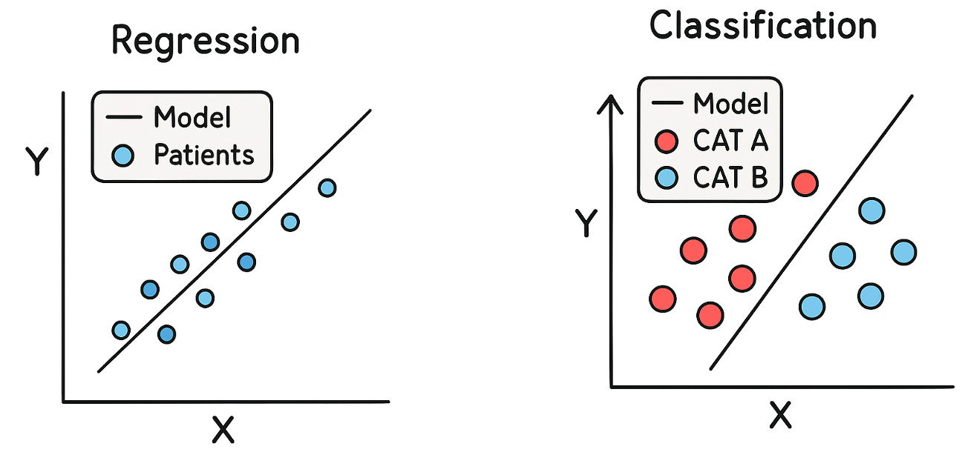
K-NN
non-parametric, supervised learning algorithm, which uses proximity to make classifications or predictions about the grouping of an individual data point
K = number of neighbours
Takes an average
House prices
Temperature prediction
Music/movie recommendation
Takes majority
Assigning labels to groups
(majority vote or species label)
Image Classification (Is it hot dog or not?)

Slide 10
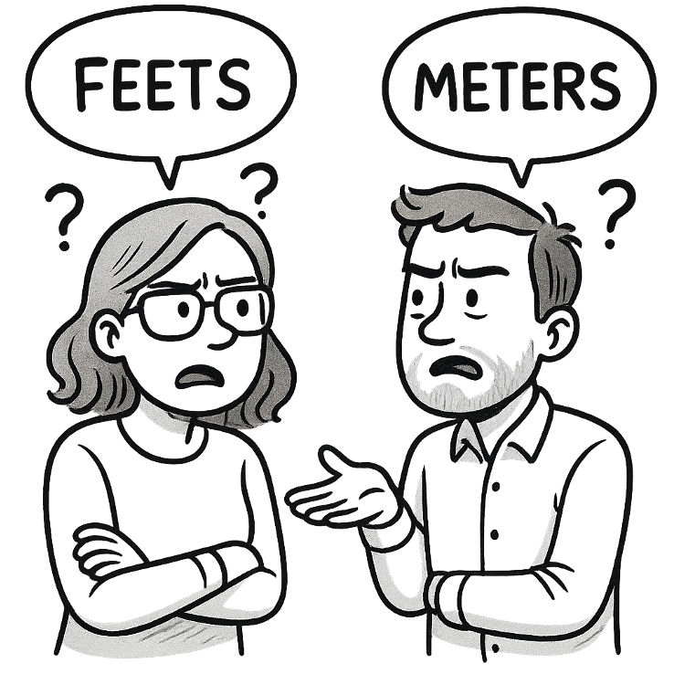
K-NN
Unless you already know the k, It’s a 2-step process
Understand the bias and variance of each k
Find the best k by finding the minimal RMSE/R2 and/or cross-validation
Ties (Regression)
Struggles with categorical data due to possible ties as it needs to either take average or pick value at random.
Scale sensitivity
The performance of the KNN is strongly affected by how large or small the values of each variable are.
Curse of dimensionality
As the number of dimensions (the number of predictors/features) increases, it becomes hard to say which points are actually close to each other (in geometrical space).

Slide 11
Bayes - very gentle introduction
Steve is a very shy and reserved soul, he has passion for details and need for structure.
What is Steve's profession?
Librarian
Farmer

Slide 12
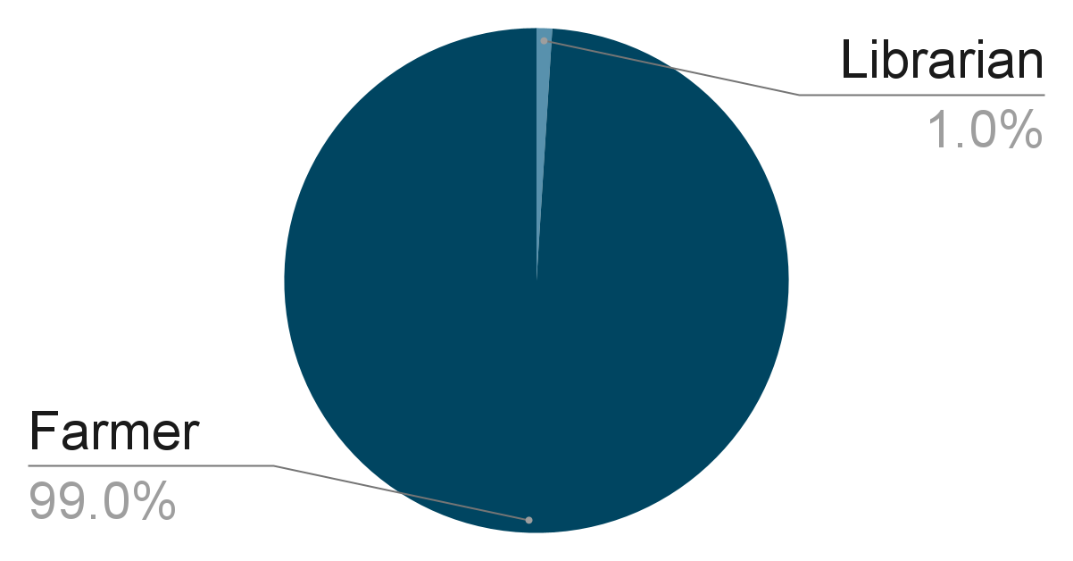
Bayes - very gentle introduction
Steve is a very shy and reserved soul, he has passion for details and need for structure.
What is Steve's profession?
Librarian
Farmer

Slide 13
Bayes - very gentle introduction
LIKELIHOOD
The probability “X” is TRUE given “Y” is TRUE
PRIOR
The probability “Y” is TRUE
P(X|Y) P(Y)
P(Y|X) =
P(X)
POSTERIOR
The probability of “Y” being TRUE given that “X” is TRUE
EVIDENCE
The probability “X” is TRUE

Slide 14
Bayes
Naive Bayes classifier
Probabilistic classifier
Naive = makes very strong (often unrealistic) assumptions > Assumes features are independent of each other
P(Data|Label) P(Label)
P(Label|Data) =
P(Data)

Slide 15
Summary
Supervised machine learning technique that assigns data points to categorical classes based on input features
There are Linear and Non-linear classifiers
KNN is often default methodology, but it can be done with regression and other techniques, such as Naieve Bayes or regression trees
Use confusion matrix to asses
Be conscious of what the task needs and how to validate

Slide 16
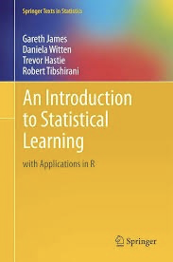
Reading and comprehension
Reading: Chapter 4.1-4.3
Comprehension: 4.8.8, 4.14 (a,b,c,f,h),
Lab: ISL 4 lab (section 4.7)

