Slide 1
Last week’s comprehension questions

Slide 2
Data Science & Machine Learning in Geography 25/26
Regression
Hierarchy
busting myths
The beyond linearity
Today

Slide 3
Hierarchy
Regression > “Linear” Regression > OLS
Any model setting predicting continuous variable.
Method of “line” fitting, relationship specification, with expected “normal” errors
Estimator/optimizer finding the line that best fits the data. "Best fit" here means minimizing the sum of squared residuals.
Assumes linearity

Slide 4
Regression
Any model setting predicting continuous variable.
Requires
Direction (ordination) - a is greater than b
Distance - c is further from a than b
Anything else, any discrete variables will be a classification problem, which have no direction or distance.
Notes:
Numerical, ordinal variables
examples: numbers, integers, but also likert scales and other “ordered” scales

Slide 5
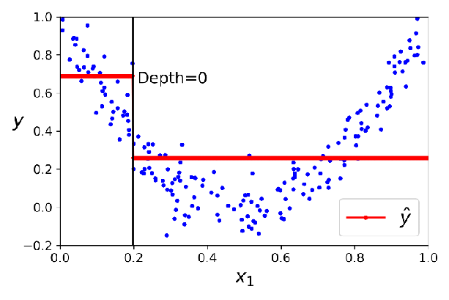
Regression
Linear regression, perhaps better generalised as General Linear Models (GLM)
Support Vector
Decision Tree
Random Forest Regression

Slide 6

Linear Regression
Traditionally: “line fitting” = finding a mathematically definable curve to capture the trend
signal
noise
See your curves
Notes:
Numerical, ordinal variables
examples: numbers, integers, but also likert scales and other “ordered” scales

Slide 7
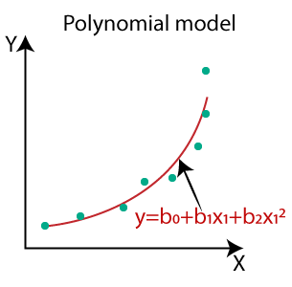
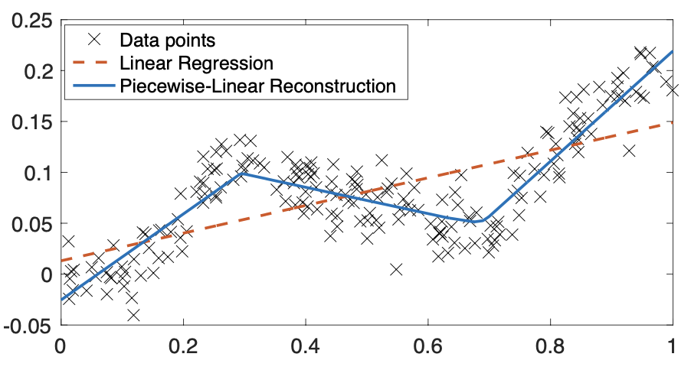
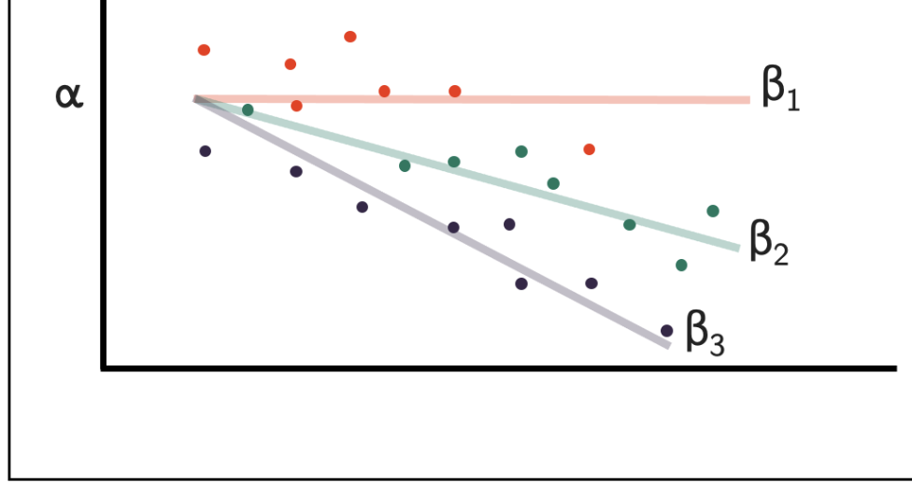
Simple Linear Regression
Multiple
Polynomial
Piecewise
Fixed Effect

Slide 8



Source
Bristols own CMM guide
Sidenote: Mixed effect models
Model | Formula syntax | Statistical formulation | Interpretation
Basic multivariate regression | y ~ x + group |  | Parallel lines; group controls baseline
Fixed effects (intercepts) | y ~ x + factor(group) |  | Same as above (re-parameterized)
Fixed effects (intercepts + slopes) | y ~ x * group |  | Separate regressions per group
Mixed effects (random intercepts) | y ~ x + (1 | group) |  | Intercepts partially pooled
Mixed effects (random slopes) | y ~ x + (x | group) |  | Slopes partially pooled
Mixed effects (random intercepts + slopes) | y ~ x + (1 + x | group) |  | Full hierarchical model

Slide 9
Cons
Sensitive to specifications :
They are rigid, not flexible.
LR will fit exactly what you tell it to fit, nothing else.
We need to be able to what curve/specification we need.
…..Specification search
Pros
Can be used to predict where there is no data
Easy to interpret ….mostly
Allows for control

Slide 10
OLS
Estimator/optimizer finding the line that best fits the data. "Best fit" here means minimizing the sum of squared residuals.
Assumes linearity
Notes:
Numerical, ordinal variables
examples: numbers, integers, but also likert scales and other “ordered” scales

Slide 11
OLS
Estimator/optimizer finding the line that best fits the data. "Best fit" here means minimizing the sum of squared residuals.
Assumes linearity
Assumptions:
Linearity…signal, Y & X ……Y | X !
not about distributions themselves, but conditional distribution
Error … noise, truly random leftover
  Independence
  Constant Error Mean (unbiased)
  Constant Variance (homoscedasticity) - matters only for inference
  Normality - N(μ,σ2)
Notes:
Numerical, ordinal variables
examples: numbers, integers, but also likert scales and other “ordered” scales

Slide 12
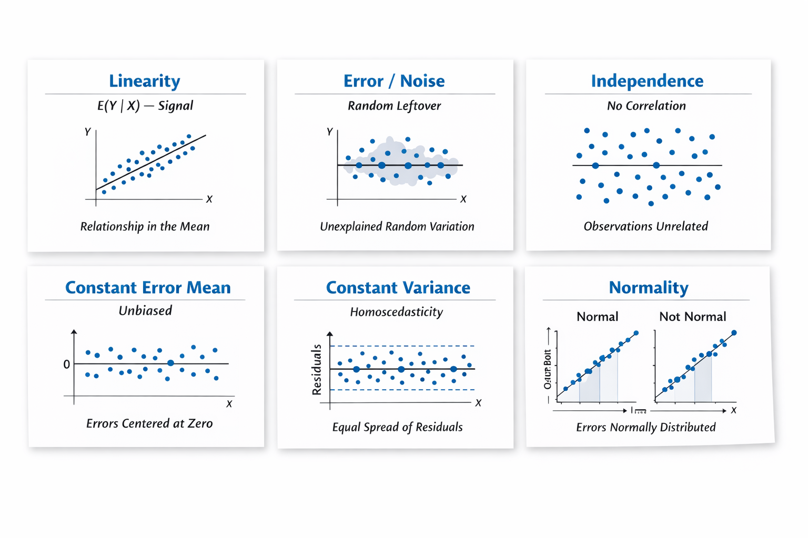
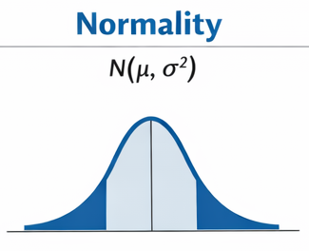
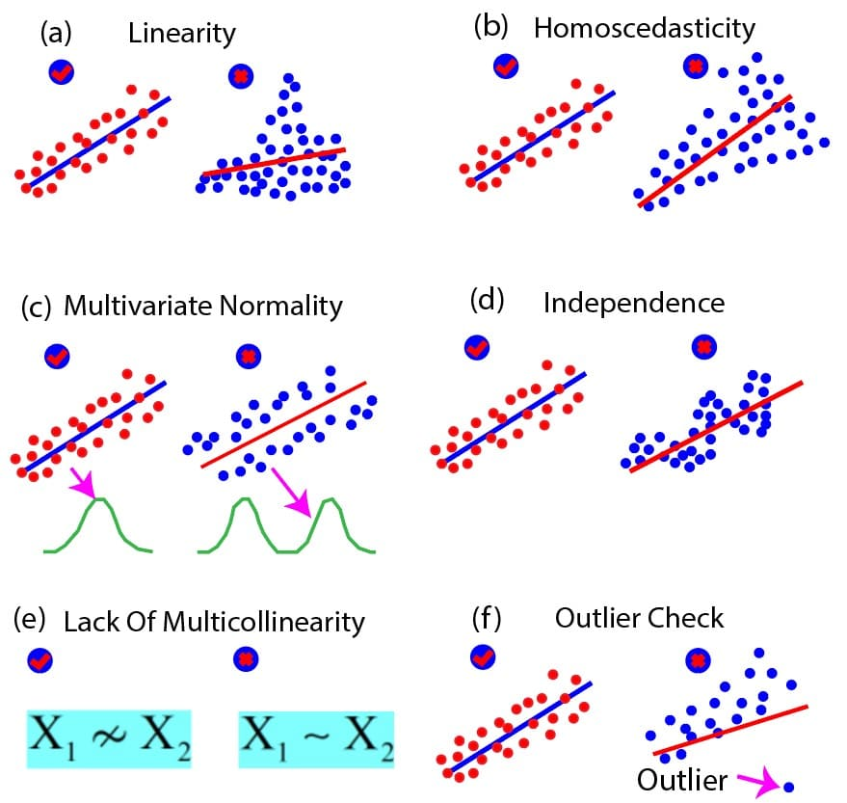
OLS
Assumptions:
Linearity…signal, Y & X ……Y | X !
not about distributions themselves,
but conditional distribution
Error … noise, truly random leftover
  Independence
  Constant Error Mean (unbiased)
  Constant Variance (homoscedasticity)
  - matters only for inference
  Normality - N(μ,σ2)
Independence
Constant Error Mean
Homoscedasticity
Notes:
Lack of independence - residuals are correlated with each other

Slide 13
solutions
Transformations
Different specification (i.e. polynomial,...)
Misspecification (i.e interactions,...)
Missing variables
Endogeneity
Different assumptions
Notes:
Numerical, ordinal variables
examples: numbers, integers, but also likert scales and other “ordered” scales

Slide 14
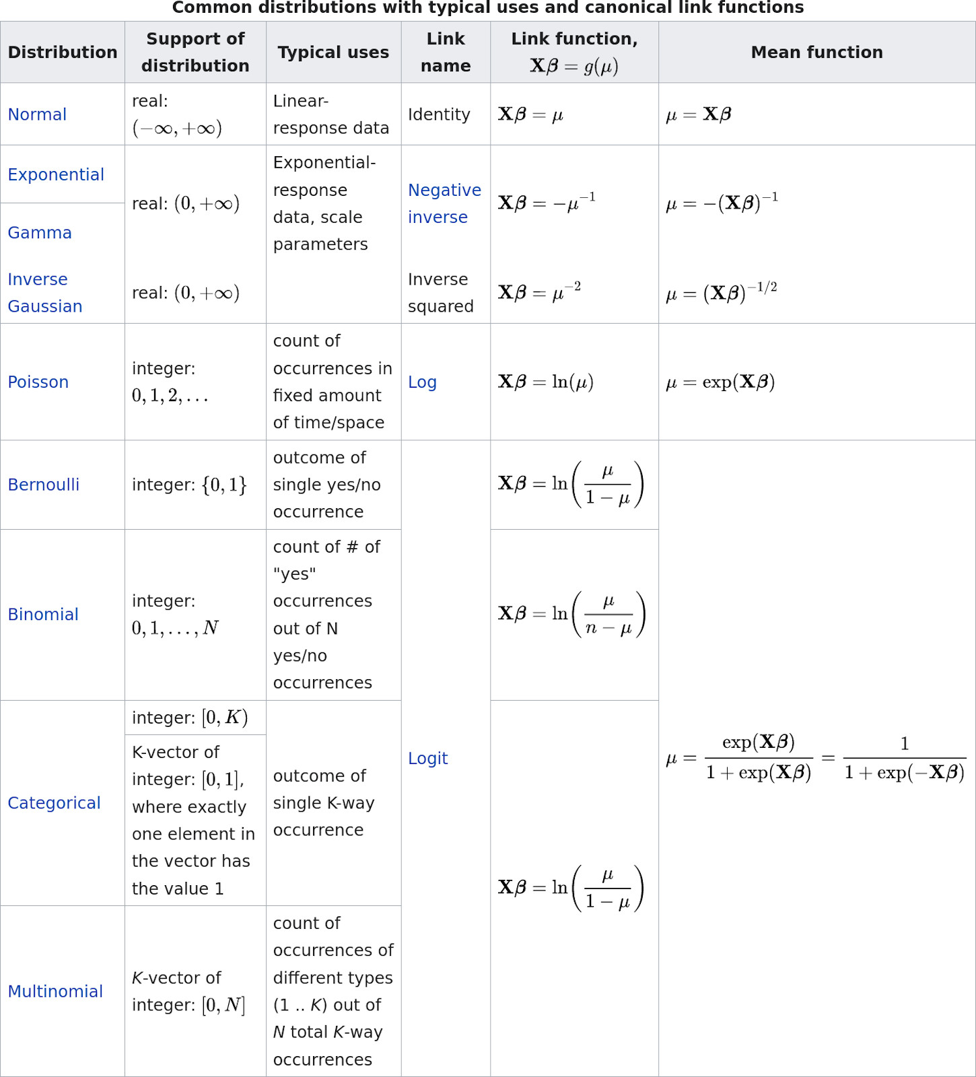
We don’t need
to be normal…
General Linear Models (GLM)
Source

Slide 15
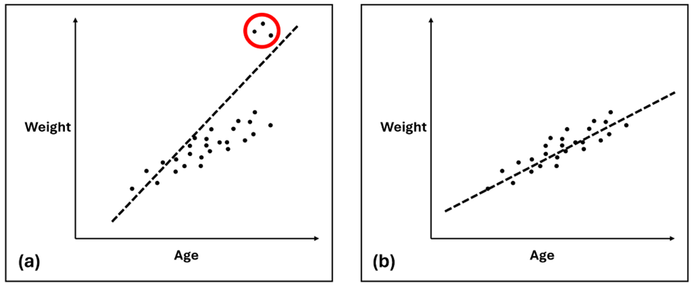
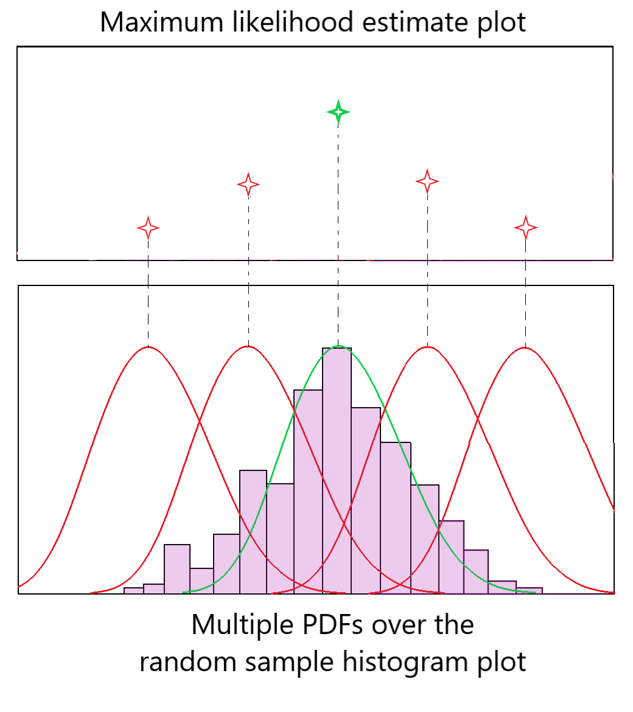
Different Loss- function
Minimum Square Error
Maximum Likelihood Estimation
aims to minimise the square errors of the model
gives the mean, the standard deviation of the random sample that is most similar to that of the whole sample
OLS
GLM

Slide 16
Summary
  Regression > Linear regression > OLS
  Regression are rigid and inflexible, but allow for control and inference
  OLS expects linear Y|X and random errors, any deviations can be observed in the residuals
  There are also non-linear and non-normal regression estimators

Slide 17
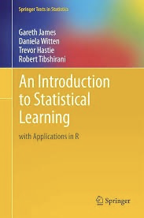
Reading and comprehension
Reading: Chapter 3
Comprehension: 3.7.2, 3.7.3, 3.7.10
Lab: ISL 3.6 + learn how to write functions in Python

