Slide 1


Data Science & Machine Learning in Geography 25/26
Intro to us & the module
The logistics
AI in Learning
Intro to Data Science
First lab
Today
Levi John Wolf
Lenka Hasova

Slide 2
Data Science & Machine Learning in Geography 25/26
What will you learn?
Basics of DS: thinking & methods
Spatial thinking within DS
Use Python to run the methods
Understand complex ML & DS methods and their use
Understand and communicate the results
What will you be able to do?
Work independently
Understand data modelling principles and set goals
Recognise & solve problems
Engage with wider context
Communicate your work
What will you become?
More than just a data analyst
Aware of the data & computation needs
Ready to adapt your skillset to a challenging environment
Critical to ML techniques

Slide 3
Data Science & Machine Learning in Geography 25/26
Word of advice:
Adjust your mindset and be ready to fail
Take a break
Ask questions
You’ll get
Understanding & Support in your needs
Plenty breathing time
As many answers as I can possibly provide
Failures, repeated failures, are finger posts on the road to achievement. One fails forward toward success.
C. S. Lewis

Slide 4
Logistics
Everything exists on the blackboard

Slide 5
Use of AI
What’s your experience?

Slide 6
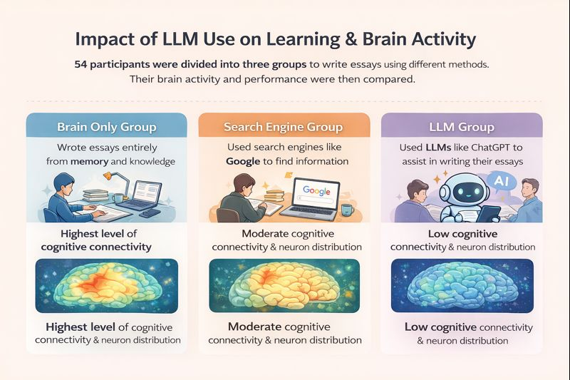

Use of AI

Slide 7
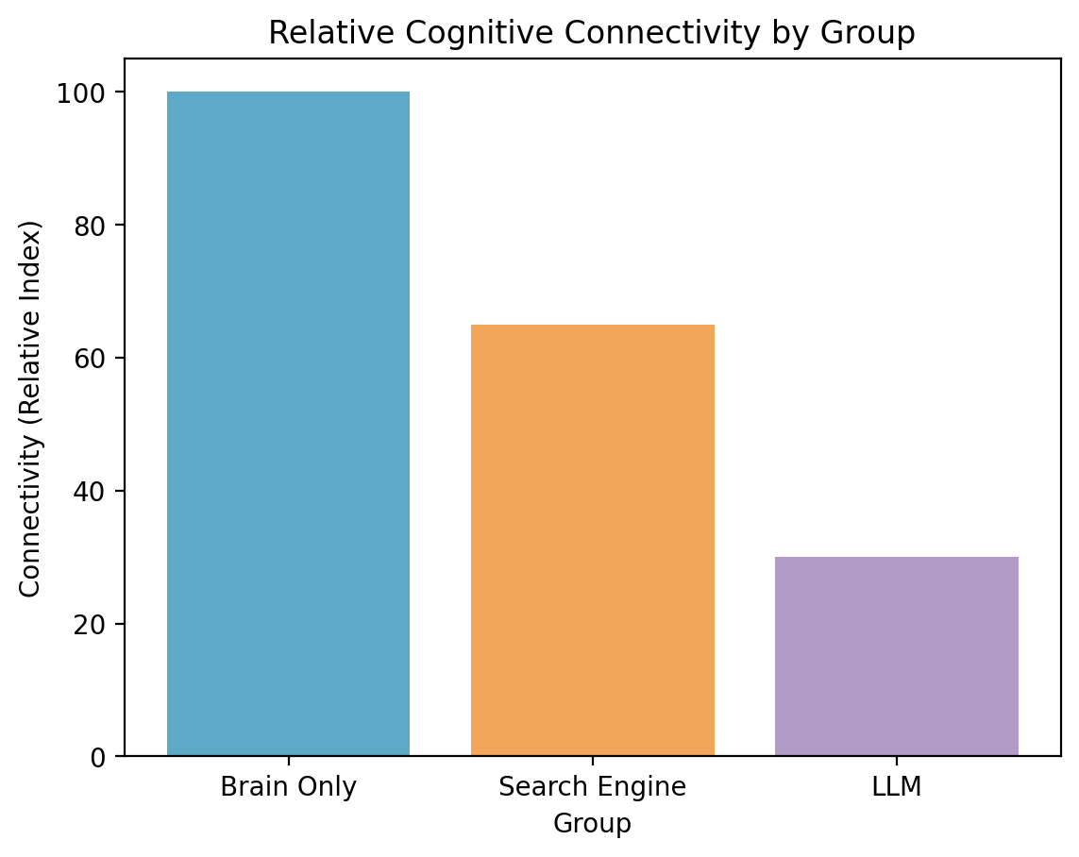
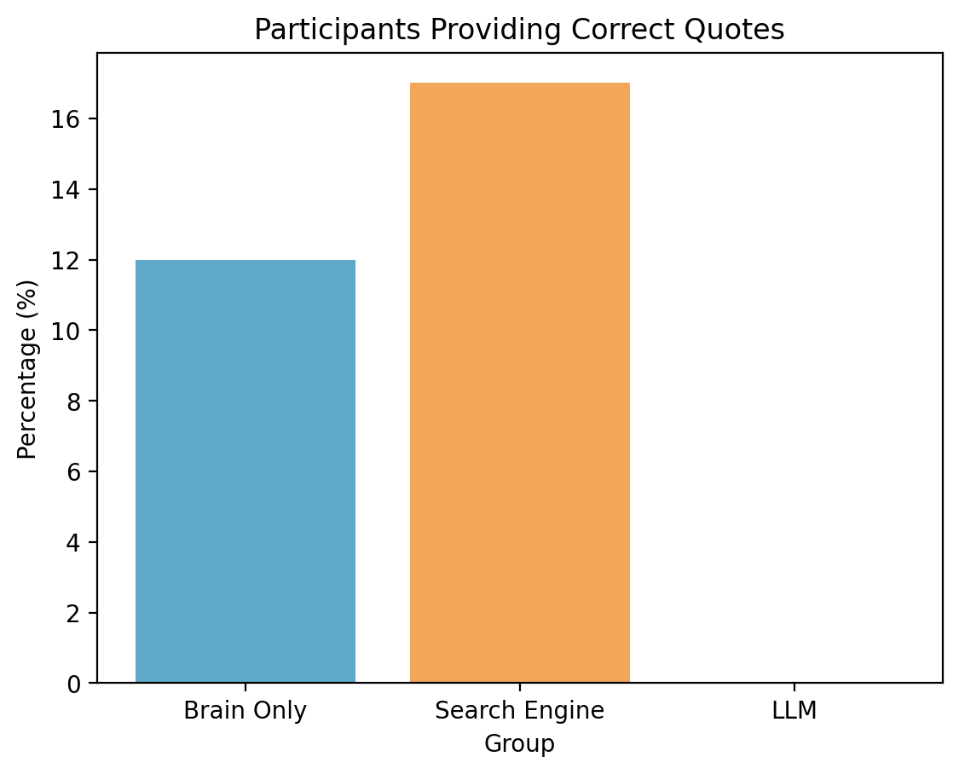
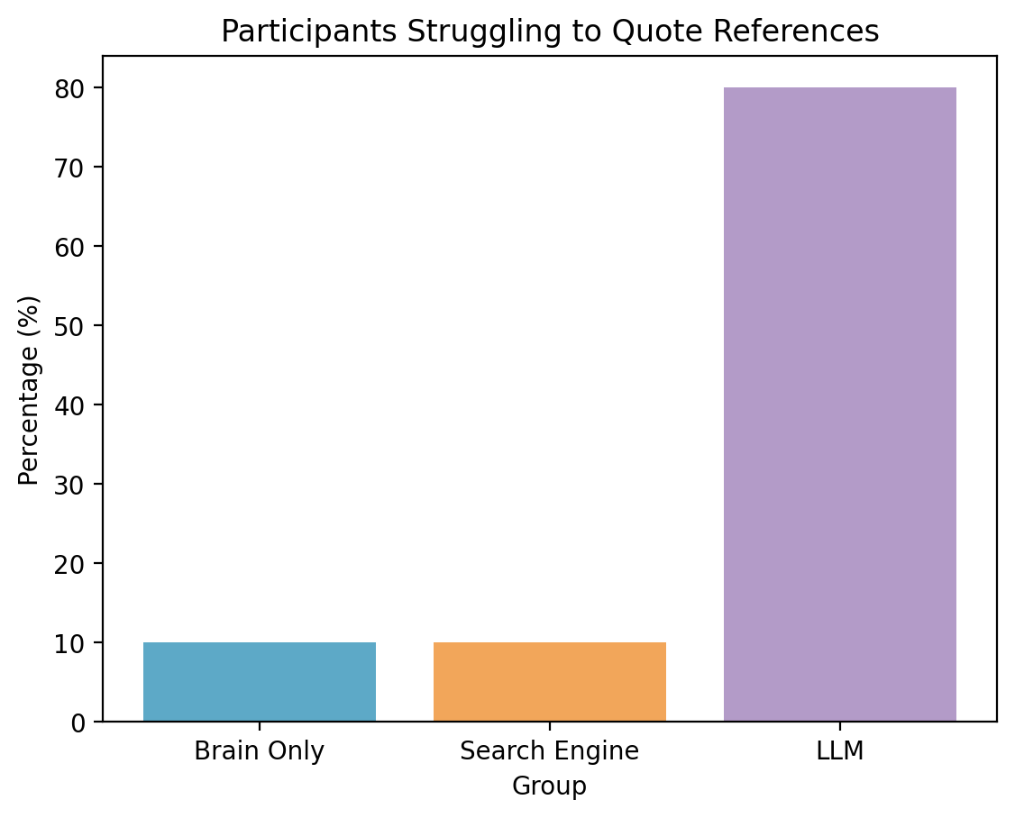
Use of AI
The study link

Slide 8
Use of AI
In this module: Category 3 Selective
Category 3: Selective - AI tools can be used in limited and clearly defined ways (per assessment), e.g. exploring concepts, suggesting structure, summarising key ideas etc – depending on the purpose of the assessment, and using AI as a tutor in the process of developing an assessment. (Further examples are provided in the AI allowable usage briefs.)
Allowed: Use of Copilot in R or Python, Use of AI for spelling (Grammarly, or other), use of LLM to aid general understanding and reframing or code help where repetitive tasks are needed…this is indirect use which requires you to build some knowledge first, but use AI to aid the labour part
Not allowed: shameless copy-pasting, any direct use/learning, over-reliance….this will affect your learning ability & will be considered as plagiarism
At the end of the day, this is your own responsibility

Slide 9
Week 1: Intro to Data Science
Brief history
Basic principles – what are the goals?
  Computation over math
  Flexibility
  Bias-variance tradeoff
3. Run through basic terminology

Slide 10
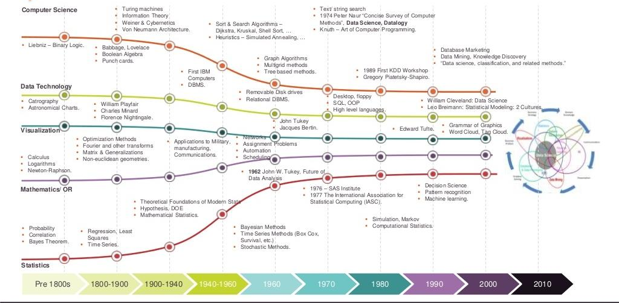
Brief history

Slide 11
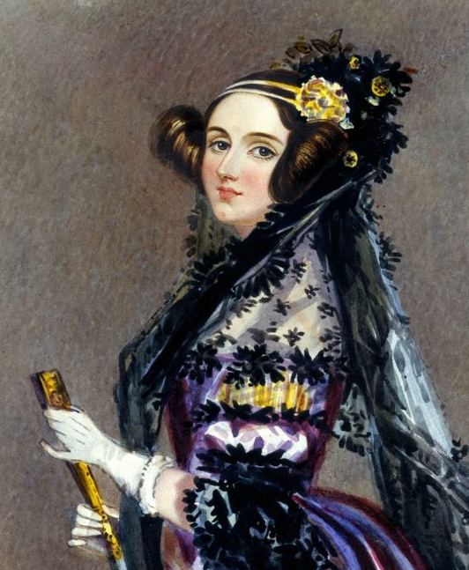
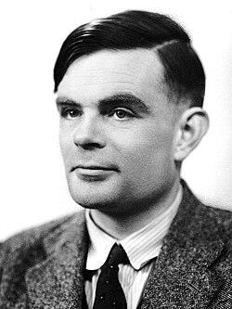
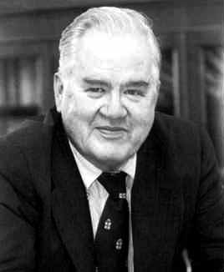
Brief history
First to explicitly articulate the notion that an engine (computer) has the potential to be used for more than just calculation.
Ada Lovelace (1815-1852)
Formalised the concept of an algorithm, developed the ‘modern computer’.
Alan Turing (1912-1954)
First ”data scientist” who established the modern field of data science and data analysis.
John Tukey (1915-2000)

Slide 12
Brief history
Interested in data visualization, reorganization, and understanding of their complexity
Stresses the need for iteration in data analysis
First to use the terms Exploratory Data Analysis (EDA), Box-plot and a bit
John Tukey (1915-2000)
Statistics uses math to minimise computation
Data Science uses computation to avoid math
“An approximate answer to the right problem is worth a good deal more than an exact answer to an approximate problem.”

Slide 13
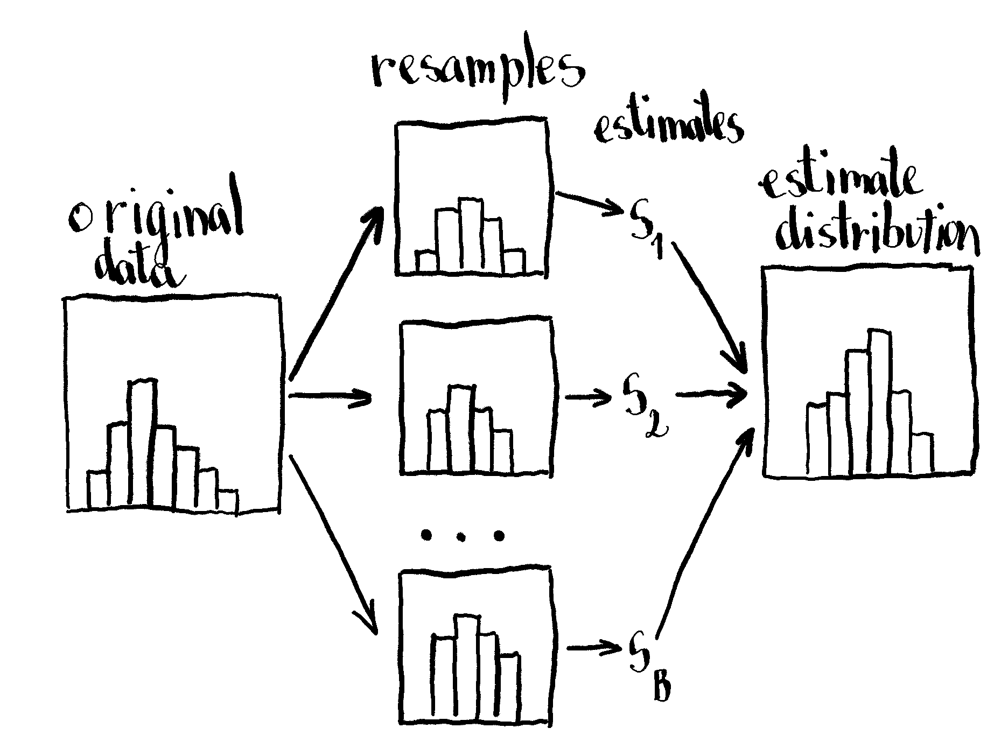
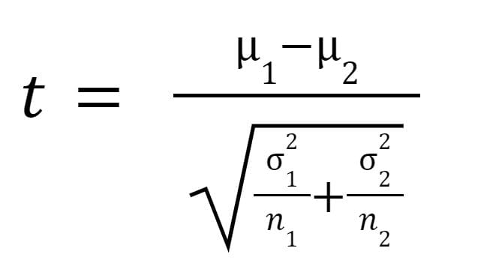
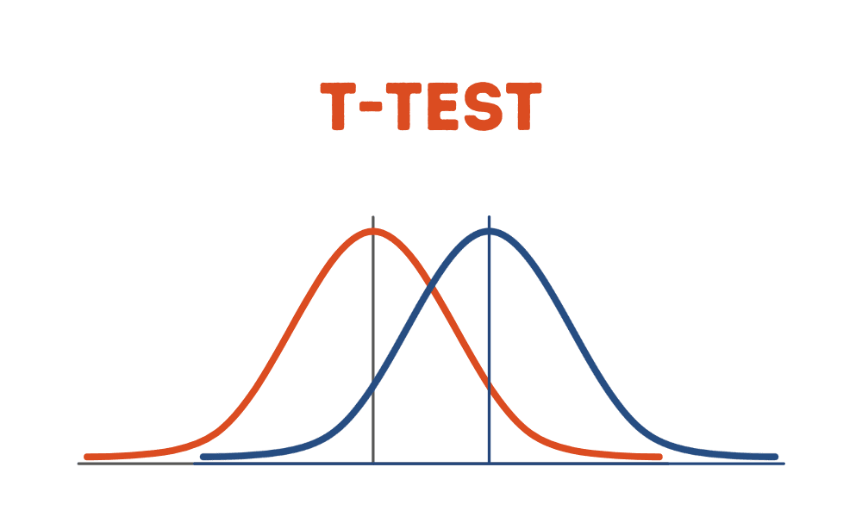
Computation over math
Statistics uses math to minimise computation
Data Science uses computation to avoid math

Slide 14
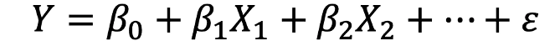
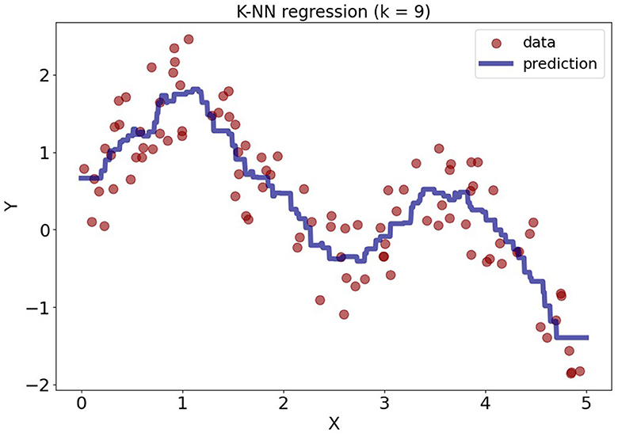
Flexibility
able to wrap itself around the data, find the pattern, if you let it
Statistics approach: Linear regression
Data Science approach: K- Nearest Neighbour
for each K neighbouring points, find an average
local learner
Find/set rules, associations, assumptions,…a learner function
In data science, everything is about making decision while minimizing loss

Slide 15
Flexibility
Find rules, associations, assumptions,…a learner function
In data science, everything is about making decision while minimizing loss
Prediction
over
Inference
loss is the cost of incorrect prediction
k=1 too flexible
k=9
flexible enough to be able to predict

Slide 16
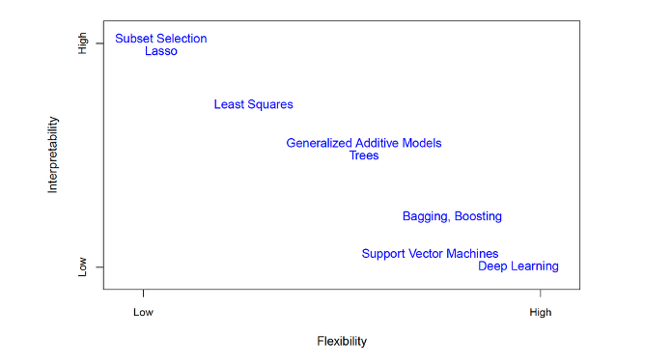
ISL book
KNN

Slide 17
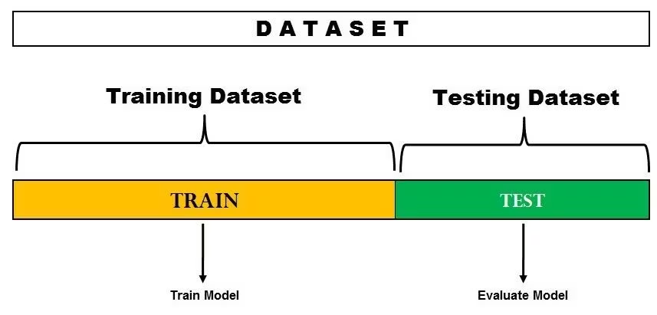
Prediction
Cross-validation - test your model accuracy within your data
In-Sample validation
Out-of-Sample validation

Slide 18
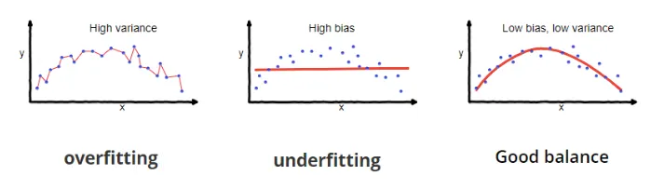
Bias-Variance tradeoff
Bias – How well the algorithm fits to the observed data / Systematic over-under prediction
Variance – How well the algorithm predicts new data / How well does the model generalises the pattern

Slide 19
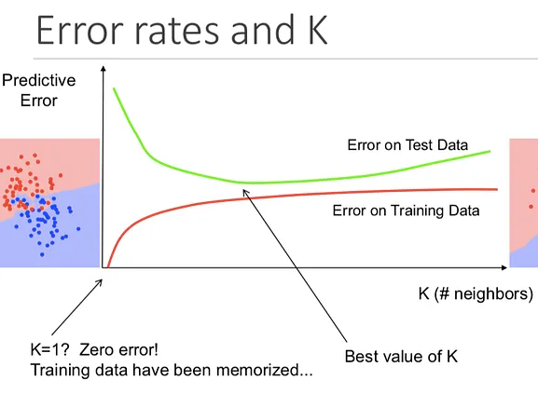
Bias-Variance tradeoff
K- Nearest Neighbour

Slide 20
Terminology
Prediction - do I want to predict for new data
OR
Inference - do I want to learn about the relationships?
Parametric - Making assumption about the data
OR
Non-parametric - Not making assumption about data
Linear regression has normality, stable parameters
No stable parameters, KNN is mapping the data structure
Recover the true answer...
Supervised - do I know the true answer?/DO I have y?
OR
Unsupervised - do I know the true answer?/DO I have y?
Clustering, targeted advertisement,...
Classification - categorical/discrete y
OR
Regression - continuous y

Slide 21
Summary
  DS/ML uses computation over math
  Flexible techniques that accept bias in favor of lower variance
  Asses models based on ou-of-sample fit mainly

Slide 22
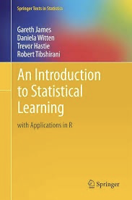
Reading and comprehension
Reading: Chapter 2
Comprehension: 2.4.1, 2.4.2, 2.4.10
Lab: ISL 2.3

